Slide 1
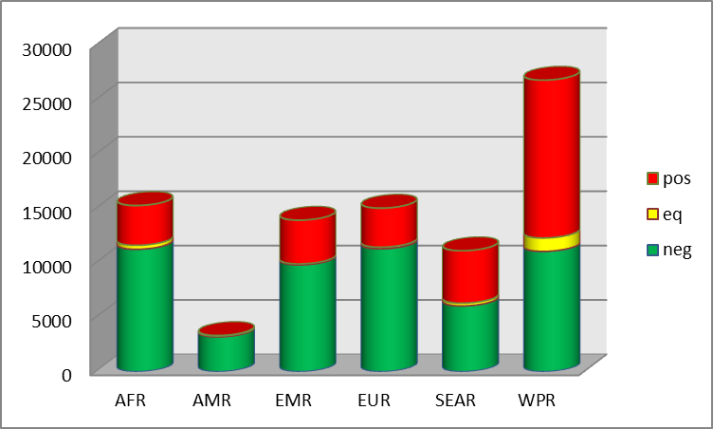
Worldwide Measles Laboratory Workload in 2014*
Global total: 85,513 specimen tested for measles IgM: 30,676 were positive
Source: surveillance DEF file sent to WHO
World Health Organization Regional (WHO) Offices:
AFR- Africa; AMR-Americas; EMR- Eastern Mediterranean;
EUR-Europe; SEAR-Southeast Asia; WPR-Western Pacific
Data in HQ as of Aug 2014

