Slide 1
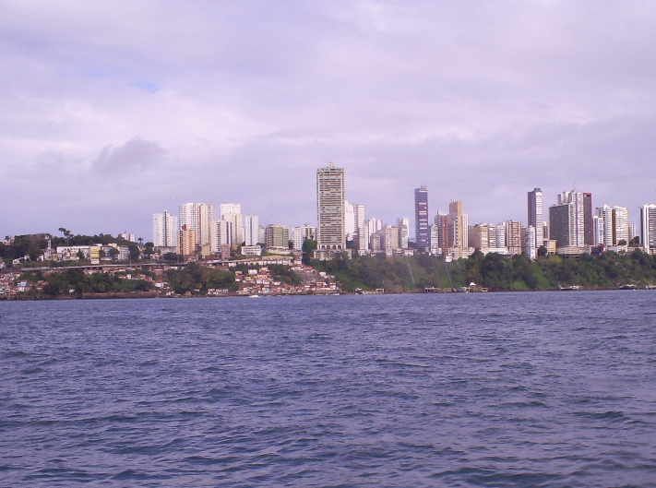
PAHO/WHO Collaborating Centers Meeting – SDE
National Institute of Enviromental Health Science
Research Triangle Park
Durham, NC, October 24, 2011
Water and Health in Brazil
Ministério da Saúde
Secretaria de Vigilância em Saúde
Ministério da Saúde do Brasil

Slide 2
Public Health XXI Century Big Picture
demographic, epidemiologic and nutritional transitions
Socio-environmental risks and vulnerabilities
Global economic dinamic
Characterized by phenonema which scale and speed were never experienced before, where the theoretical model more frequently adopted do not offer the best answers to explain the reality, demanding the search for more complex theoretical modeling approach (Tambellini, AMT. Rigotto, RM. Giraldo, LA. Firpo, M. Lacaz, FAC.)

Slide 3
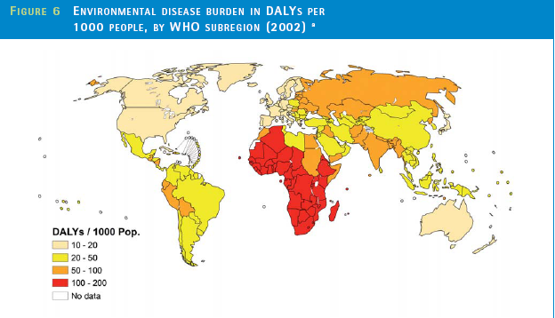
WHO estimates that 30% of health warm are related to environmental factors, such as:
inadequate sanitation
air pollution
exposure to chemicals and phisical pollutants
natural disasters
biologic factos (vectors, hosts e reservoirs)

Slide 4
DISEASES RELATED TO CONTAMINATED WATER
WHO: 1,5 million of deaths, were 88% are attributable to contaminated water, inadequate sanitation or poor hygene
BRAZIL – these conditions reached 325,4 admissions/100.000 unhabitants in 2010.

Slide 5
Departamento de Saúde Ambiental e Saúde do Trabalhador
Coordenação Geral de Vigilância em Saúde Ambiental
Environmental Health
Public Health area concerned with the cientific knowledge and the formulation of public policies related to the interaction between health and environmental factors, either natural or man made in order to improve life quality, according to the sustainability agenda.
(CGVAM, ABRASCO, 2003)
Notes:
5

Slide 6
Environmental Health
Logic Framework - I
SUSTAINABLE
DEVELOPMENT
DEVELOPMENT
NATIONAL PLAN
MILENIUM OBJECTIVES AND GOALS
STRATEGIC PLAN PAHO/WHO 2007/2012
NATIONAL HEALTH PLAN
PACT FOR HEALTH
HEALTH PROMOTION NATIONAL POLICY/ ENVIRONMENTAL HEALTH

Slide 7
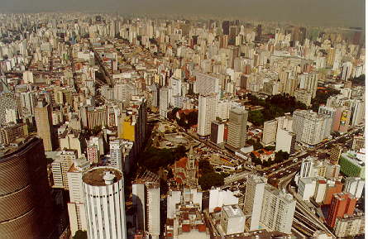
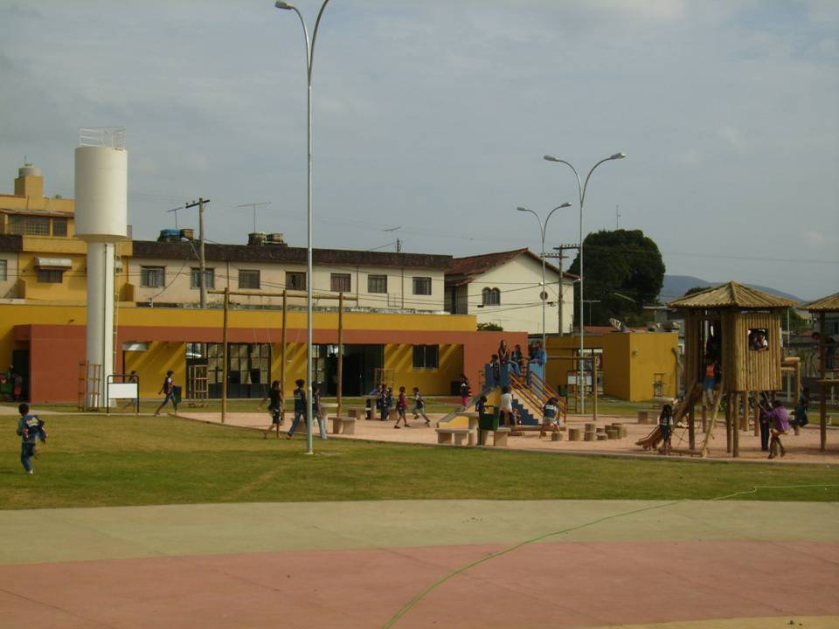
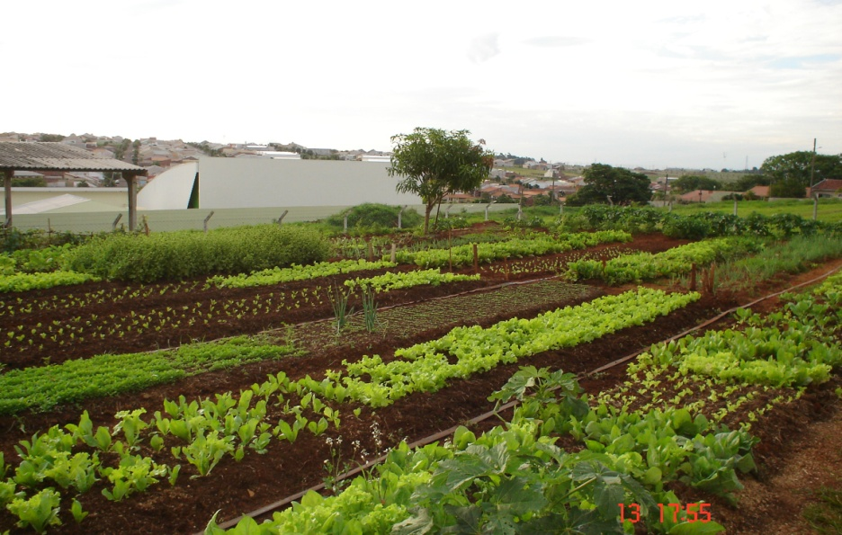
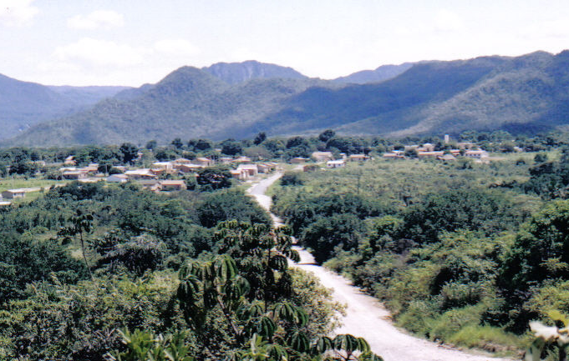
Brazilian Territories
Metropolitan Areas
Suburban Areas
Rural Area
Tradicional Territories
Notes:
7

Slide 8
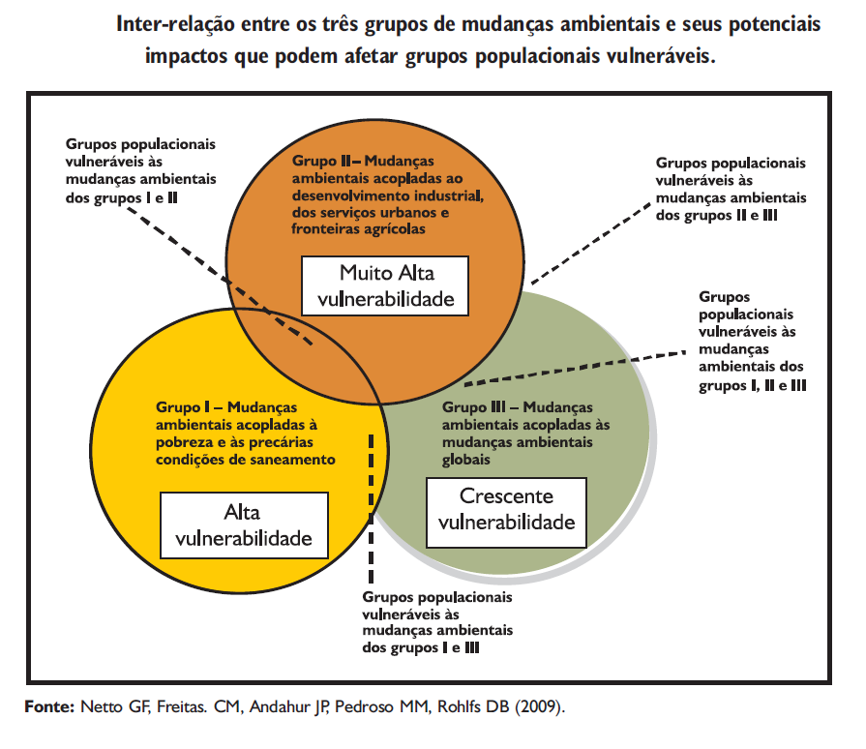

Slide 9
Equity Challenge
Table – Brasilian municipalities with extreme HDI and correspondent countries, 2000.
HDI | Municipality | Country
0,919 | São Caetano do Sul, SP | Irland
0,908 | Águas de São Pedro, SP | Italy
0,886 | Niterói, RJ | Greece
0,875 | Florianópolis, SC | Malta
0,871 | Santos, SP | Barbados
0,486 | Centro do Guilherme, MA | Laos
0,479 | Guaribas, PI | Iemen
0,479 | Iraipú, AL | Iemen
0,475 | Jordão, AC | Haiti
0,467 | Marani, PE | Madagascar
Carneiro, FF. Netto, GF. Corvalán, C. Machado, CMF. 2010

Slide 10
Coordenação Geral de Vigilância em Saúde Ambiental
National Environmental Health Surveillance System
Actions and services provided by public and private organizations for
knowledgement, detection or prevention of any change in the environmental factors that interact with human health
To Recomend and adopt preventive and control measures related to the risk factors related to diseases and other heatlh outcome.
Notes:
10

Slide 11
Implementation Framework - II
SUSTAINABLE
DEVELOPMENT
RISKS AND
VULNERABILITIES
REDUCTION
HEALTH
PROMOTION
ENVIRONMENTAL
HEALTH
LIFE AND HEALTH
QUALITY
PUBLIC
POLICY
INSTRUMENTATION

Slide 12
Intersectorial Framework
Environmental
Health
Survellance
Water Resources
Environmental
Sector
Consumer defense attorney
Sanitation Sector
Lab QI/QC
Universities
NGO and Civil Society

Slide 13
Environmental Health Indicators
Seek to work with socio-enviromental health determination Search for friendship methodologies Headlamp Project (Environmental Health Analisis for decision making as a Cooperation among PNUMA, EPA, WHO)

Slide 14
WHO model defines an hierarquic model that includs five levels, classified as:
Driving forces: represented by the more general characteristics of the developing model adopted by the society.
Pressure: Expressions from the conditions above in the environment, mainly the geographic economic exploration;
State: Environmental dynamics;
Exposure: ammount of human exposure;
Effects: Heatlh effects related to that exposure.
Action: For each of the above, action can be taken.
(Corvalán et al, 1996; Domingues, 2001).

Slide 15
The Environmental Health Chain
Atividades Fonte
Industry
and
Energy
Household activities
Waste Management
Drivin
Forces
Transport
Agriculture
Pressures
Emissions
Environmental pollution
State
Air
Water
Food
Soil
Exposure
Exposition
Absorved dose
Health Effects
Effect
Premature/ Subclinical
Moderate/ Clinical
Advanced/ Permanents
Sorce: WHO, 2001

Slide 16
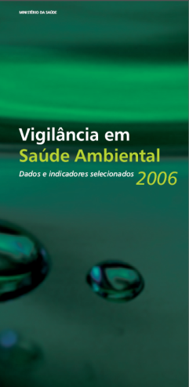
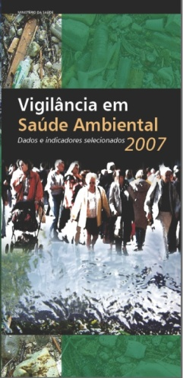
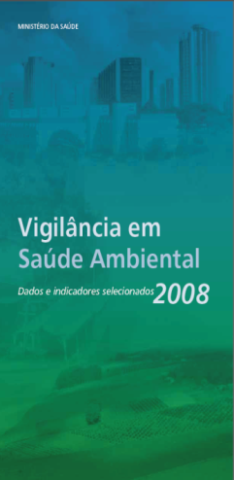
Environmental Health Surveillance Folder: Selected Data and Indicators: Brazil – 2006, 2007, 2008

Slide 17
DRINKING WATER SURVEILLANCE NATIONAL PROGRAM
VIGIAGUA
BASED ON DRINKING WATER
STANDARS AND CRITERIA SET BY MoH ORDINANCE

Slide 18
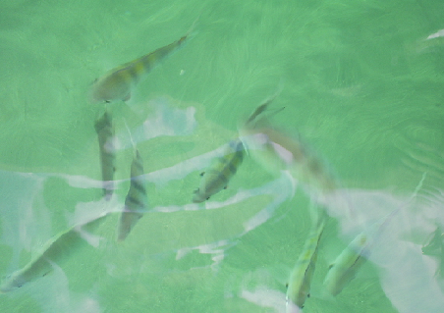
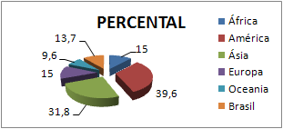
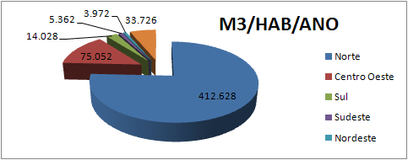
WATER IN THE WORLD AND IN BRAZIL
Freshwater in the world
(superficial)
Freshwater in Brazil
Fonte: ANA
Fonte: M Cid
GENERAL CHARACTERISTICS
1 – Inequality among Continents
2 – Intequalities within Brasil
Brazilian Average: 33.723 m3/unhab/year
(North > 400.000 – Northeast < 4.000)

Slide 19
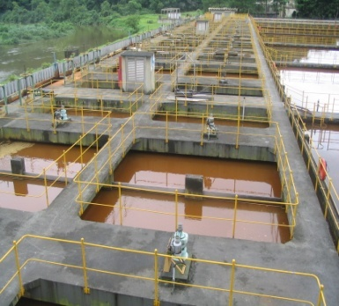
VIGIAGUA Operacionalization
Municipality basic actions
1 – To identify and inspect all types of water provision existent in the municipality: SAA, SAC e SAI
2 – To receive and approve the sampling plan developed by the drinking water providers

Slide 20
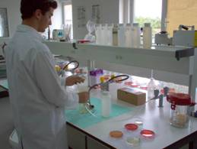
VIGIAGUA operacionalization
Municipality basic actions
3 – To receive and alalyse the drinking water control reports send by the drinking water providers
4 – To elaborate the surveillance sampling plan for the municipality
5 – To colect drinking water samples to be alalysed by the laboratory

Slide 21
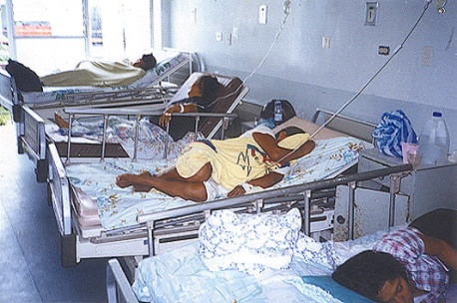
VIGIAGUA operacionalization
Municipality basic actions
6 – To receive lab results and contrast them with the control results informed by the providers
7 – To include data in the SISAGUA database
8 – To communicate drinking water providers reccomendations if standards are not achieved
9 – To evaluate epidemiologic data related to drinking water

Slide 22
VIGIAGUA operacionalization
MODULES
System cadastre (providers)
Water quality control (providers)
Water quality surveillance (health)

Slide 23
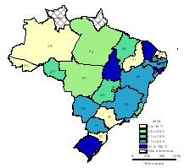
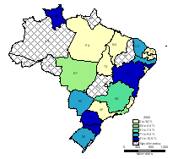
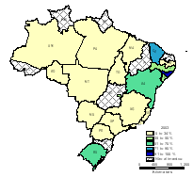
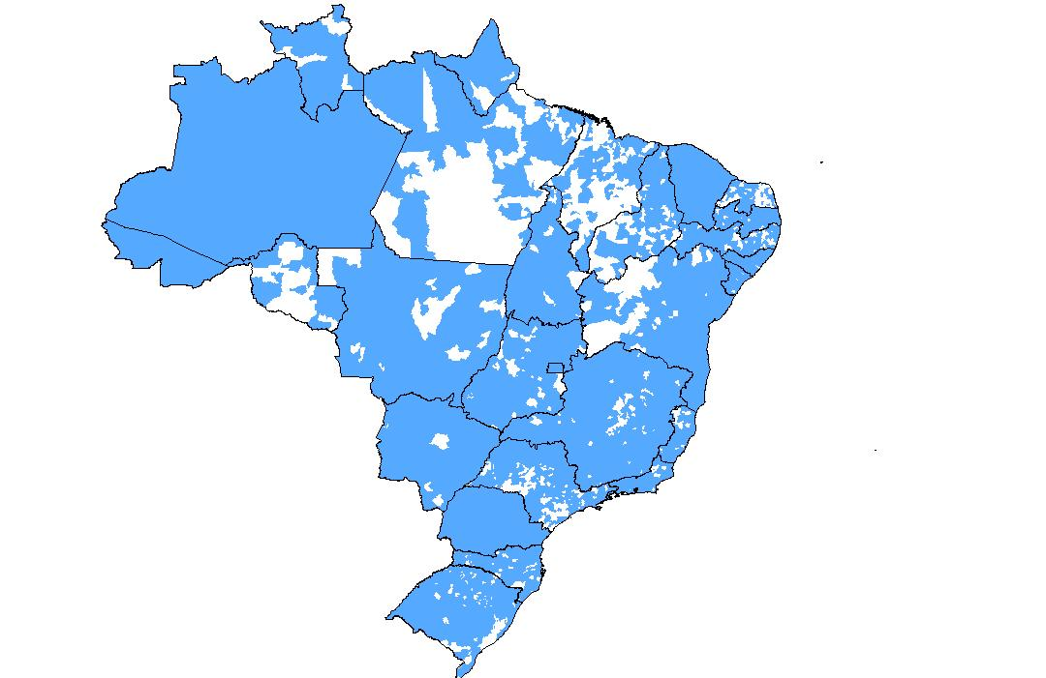
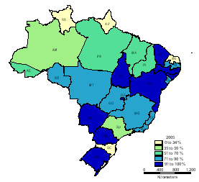
Drinking Water Survellance development in Brazil, 2002-2010
2002
2003
2004
4883 municipalities (87% total)
2005
2010

Slide 24
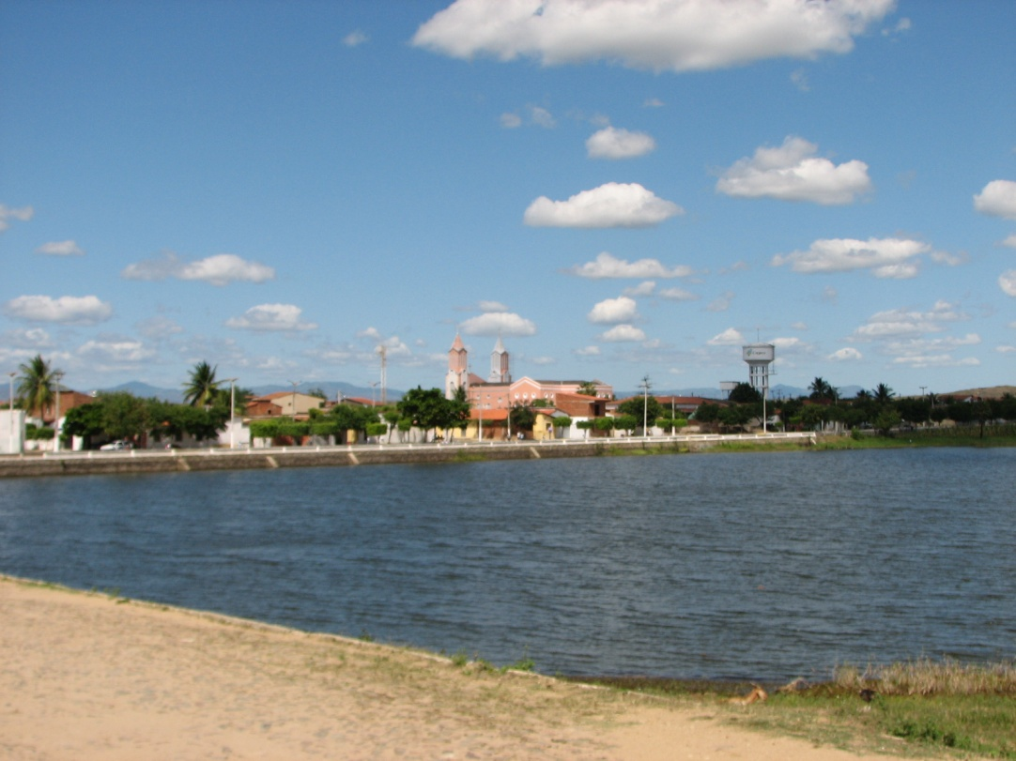
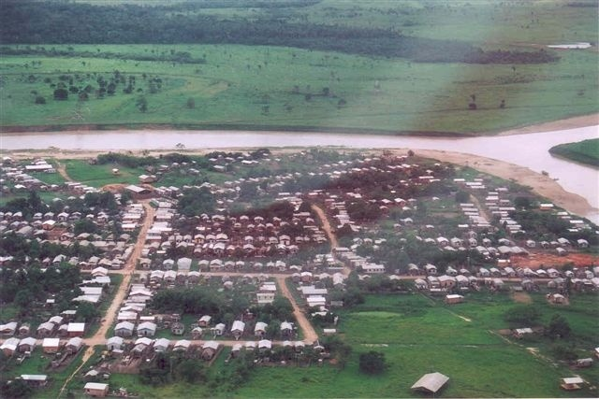
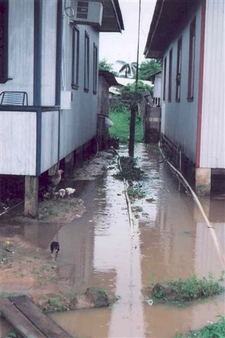
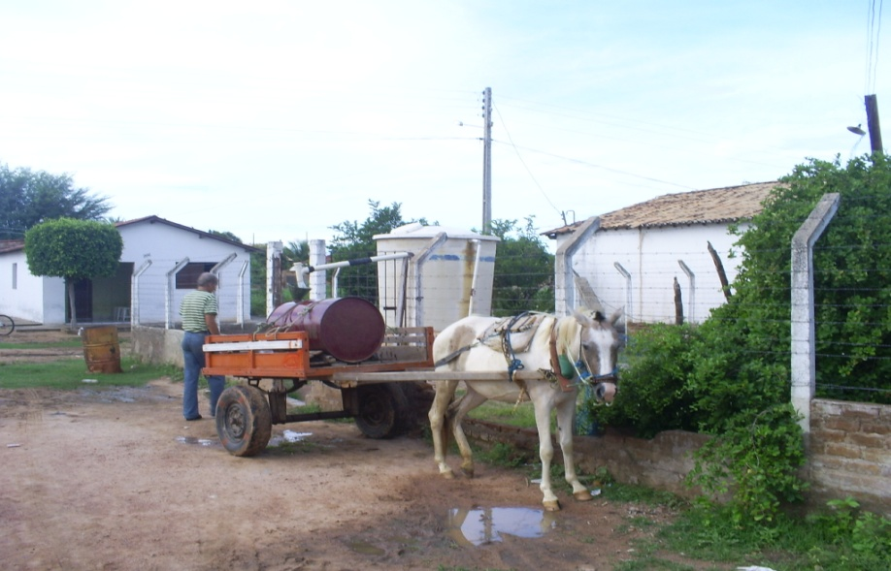
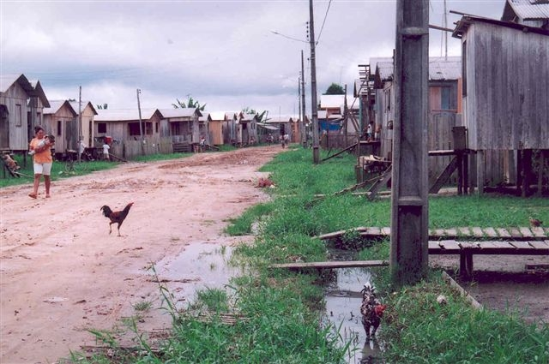
MAJOR PROBLEMS

Slide 25
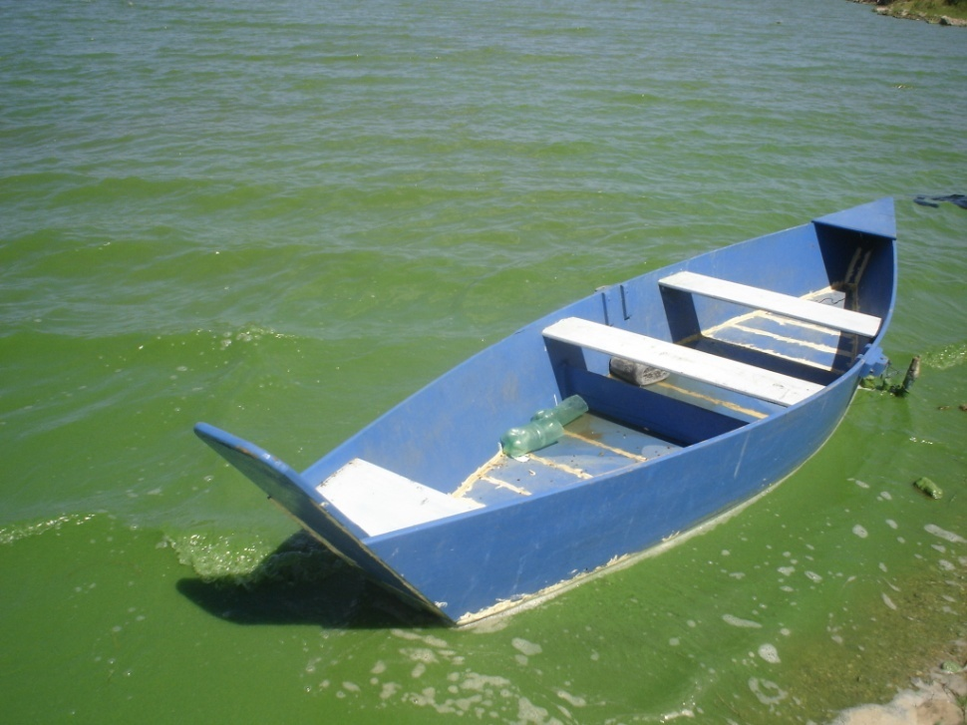
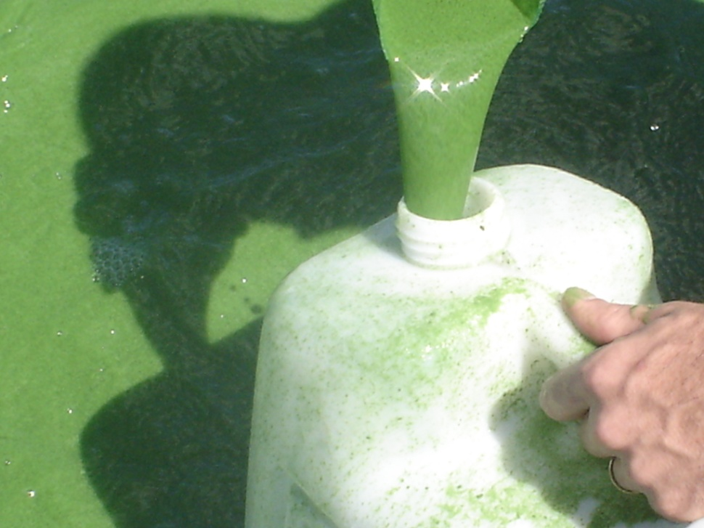
CYANOBACTERIAS - CYANOTOXINS
Tapacurá reservour - PE suplies more than 1.000.000 unhabitants from Recife Metropolitan Region (Fonte: LACEN PE)

Slide 26
Inequity Challenge
Indicators Related to Inadequate Sanitation - Brazil and regions, 2009.
Tipo de Indicador | Força Negativa De Intensidade | Índice*
 |  | Norte | Nordeste | Centro Oeste | Sudeste | Sul | País
Força Motriz | Máxima | 16,7 | 55,6 | 13,3 | - | - | 24,7
 | Alta | 50,0 | 40,7 | 20,0 | - | - | 28,3
 | Moderada | 33,3 | 3,7 | 40,0 | 58,3 | 22,8 | 22,7
 | Baixa | - | - | - | 43,7 | 77,2 | 19,8
Pressão | Máxima | 33,3 | 33,3 | 30,0 | - | - | 24,1
 | Alta | 58,4 | 27,8 | 40,0 | 12,5 | 30,0 | 35,2
 | Moderada | 8,3 | 38,9 | 10,0 | 25,0 | 30,0 | 24,1
 | Baixa | - | - | 20,0 | 62,5 | 60,0 | 17,6
Estado | Máxima | 33,3 | 18,6 | 13,3 | 25,0 | - | 19,8
 | Alta | 55,6 | 33,3 | 26,7 | 08,3 | 11,1 | 30,9
 | Moderada | 11,1 | 48,1 | 33,3 | 08,3 | 22,2 | 28,3
 | Baixa | - | - | 26,7 | 58,4 | 66,7 | 21,0
Exposição | Máxima | 41,7 | 16,7 | 25,0 | 18,8 | - | 22,2
 | Alta | 20,9 | 47,2 | 20,0 | 12,5 | 25,0 | 28,7
 | Moderada | 20,8 | 30,6 | 25,0 | 25,0 | 16,7 | 25,0
 | Baixa | 16,6 | 20,5 | 30,0 | 43,7 | 58,3 | 24,1
Efeito | Máxima | 38,9 | 33,3 | 20,0 | - | - | 23,5
 | Alta | 33,0 | 26,0 | - | 26,7 | 33,3 | 23,5
 | Moderada | 33,3 | 26,0 | 26,7 | - | 33,3 | 24,7
 | Baixa | 11,1 | - | 20,0 | 100,0 | 66,7 | 28,4
* Freqüência de cada intensidade dividida pelo total de células de cada tipo de indicador por região e no país x 100.
Netto, GF. Freitas, CM. Andahur, JP. Pedroso, M. Rolphs, DB. 2009

Slide 27
Use of WHO environmental health indicators methodology for drinking water surveillance, Brazil and Regions, 2006.
 | Driving Forces | Pression | Situation | Exposure | Effect | Action
Regions | % Poverty (1) | % Districts without sewage treatment (2) | % households with inadequate sanitation (water, lwaste and sewage) | % of water without treatment | Hospitalar admissions due to diseases related to inadequate sanitation (by 1.000 persons) | % achieved goal for VIGIAGUA coverage
North | 46,9 | 96 | 88,2 | 21,5 | 6 | 102,8
Northeast | 57,5 | 91,1 | 69,6 | 7 | 5,8 | 152,7
Mideast | 22,1 | 68,7 | 62,8 | 3,0 | 3,6 | 232,5
Southeast | 22,3 | 72,8 | 21 | 8,3 | 1,5 | 153
South | 19,3 | 87,8 | 40,2 | 4,6 | 2,3 | 93
Brazil | 40 | 86 | 63 | 9,8 | 4,5 | 138,5
Source: MS, 2007

Slide 28
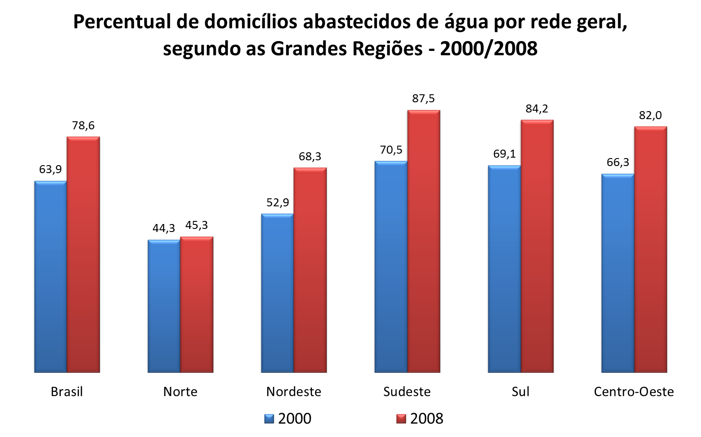
% of households supplied by piped water suply,
by Region – 2000/2008
Fonte: IBGE - Pesquisa Nacional de Saneamento Básico - PNSB

Slide 29
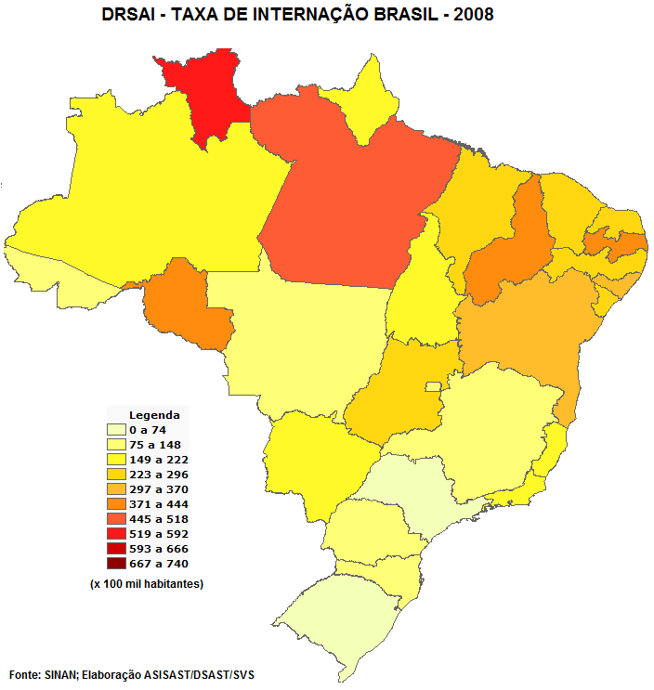
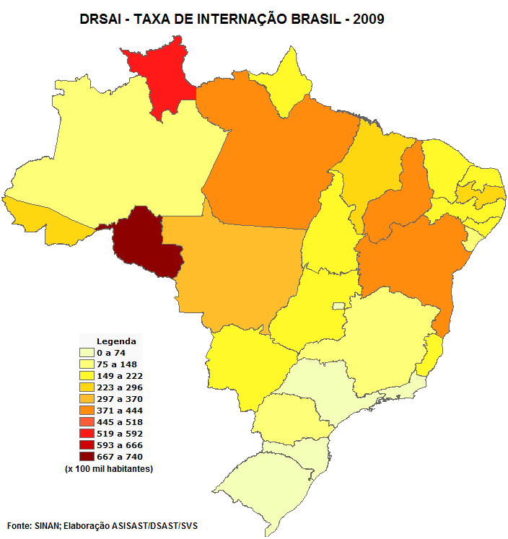
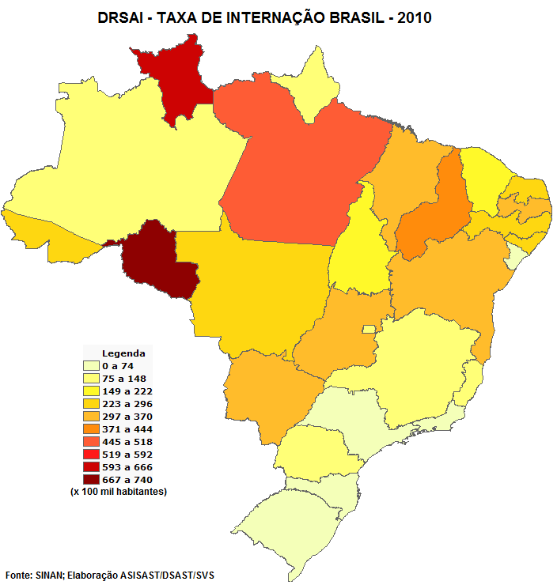
Inadequate Sanitation - Brazil and States, 2008 - 2010.

Slide 30
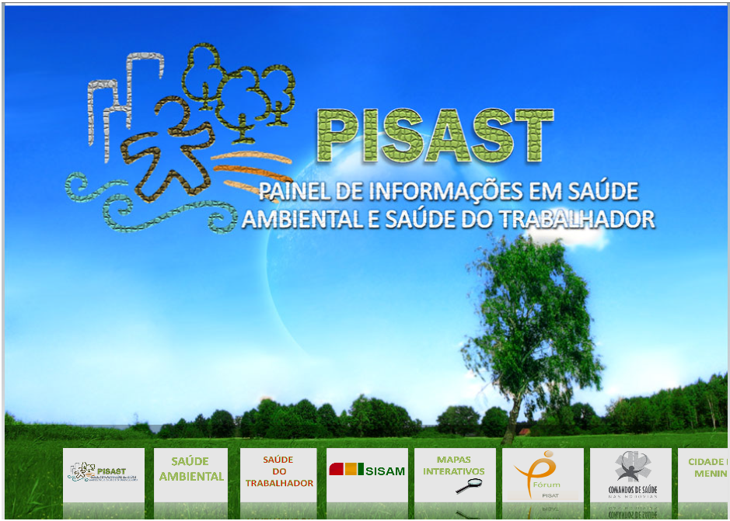
Situational Envionmental Health Analysis
Capacity to oganize information about identification, monitoring and evaluation of environmental health determinants that cause impact in the quality of life in specific territories. It offer opportunity to not only assess epidemiologic data regarding death, disease, injury and risk, but it make available to understand some of the major vulnerabilities of the human settlements.
www.saude.gov.br/svs/pisast

Slide 31
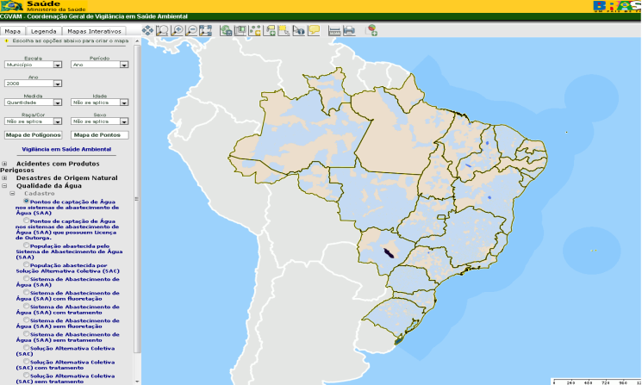
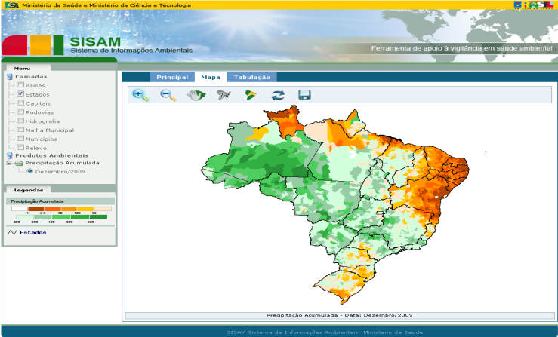
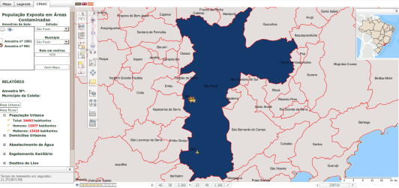
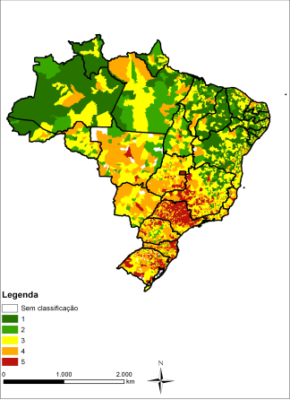
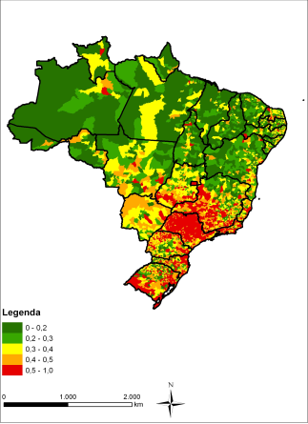
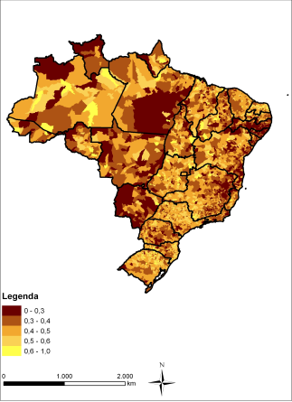
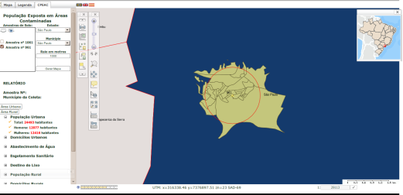
Sistema de Informações Ambientais Integrados a Saúde Ambiental - SISAM
Mapas Interativos
Cálculo de População Potencialmente Exposta a Contaminantes Químicos - CPAQ
Atlas Brasileiro de Vulnerabilidade Socioambiental

Slide 32
Brazil achieves the goal in reducind half of the urban population without access to potable water but most of rural areas remain uncovered

Slide 33
MAJOR CHALLENGES IN SANITATION
ACCELERATING GROWTH PLAN – PAC II (2011/2015)– U$ 24 billion
BASIC SANITATION FINANCIAL NEED ~ U$ 100 billion
REINFORCE LEGISLATION AND REGULATION

Slide 34
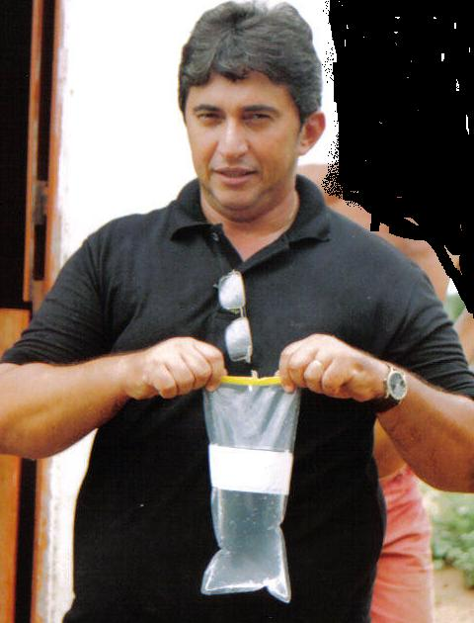
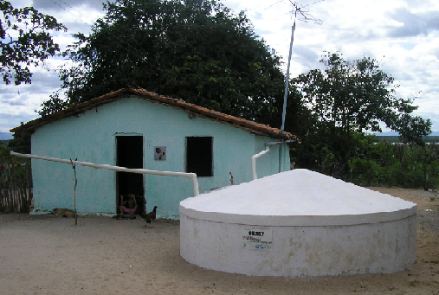
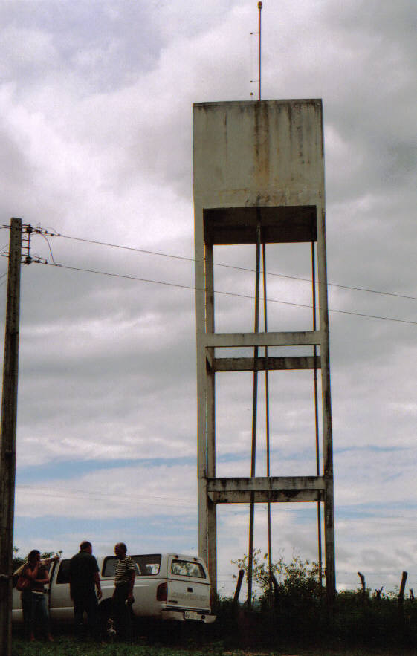
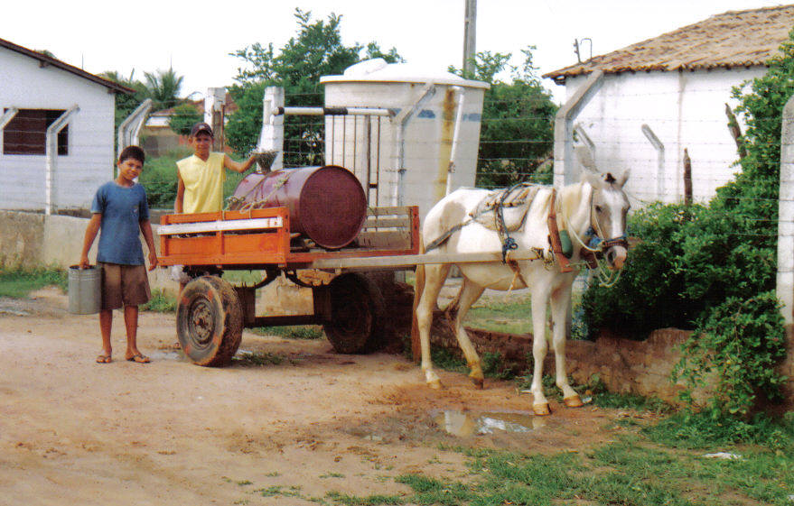
Water for All Program
Install 1.230.000 household tanks in the semi arid

Slide 35
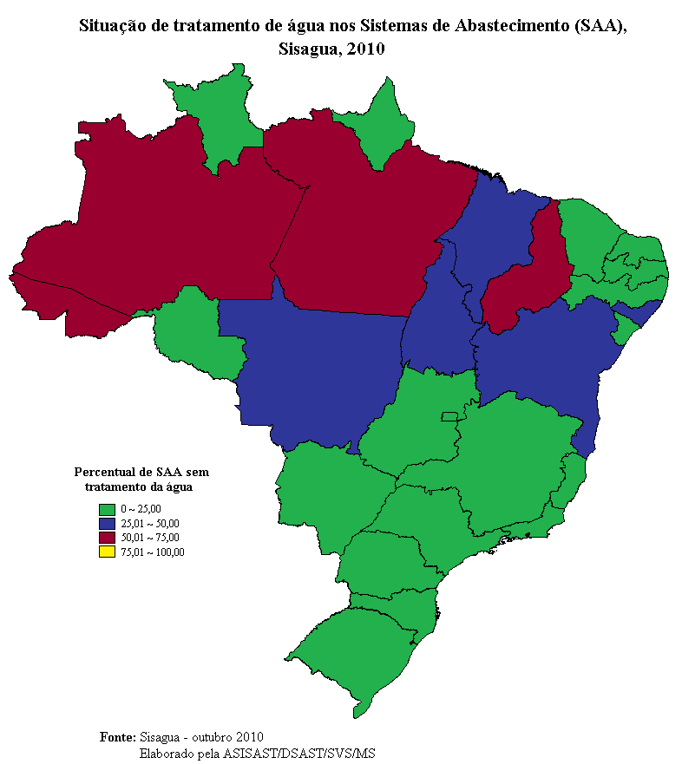
Drinking water Surveillance in Brazil - Challenges
To improve drinking water quality and treatment
To integrate actions with primary health care services in the territory.
To identify health risk sources related to contaminated drinking water
To reduce morbimortality related to contaminated drinking water.
To evaluate program impact
To implement water safety plan approach

Slide 36
Bibliography
BELLEN, H. M. van. Indicadores de Sustentabilidade: uma análise comparativa. Rio de Janeiro: Editora FGV, 2005.
INSTITUTO BRASILEIRO DE GEOGRAFIA E ESTATÍSTICA. Indicadores de Desenvolvimento Sustentável: Brasil 2008. Rio de Janeiro: IBGE, 2008. Disponível em: <www.ibge.gov.br/home/geociencias/recursosnaturais/ids/default.shtm?c=1>.
JANNUZZI, P. M. Indicadores Sociais no Brasil: conceitos, fontes de dados e aplicações. Campinas: Alínea, 2004.
MACIEL FILHO, A. A. e col. Indicadores de vigilância ambiental em saúde. Informe Epidemiológico do SUS, 8(3): 59-66, 1999.
MINISTÉRIO DA SAÚDE. Vigilância em Saúde Ambiental: dados e indicadores selecionados. Brasília: Ministério da Saúde, 2008. v. 1, n. 1. Disponível em: <www.saude.gov.br/svs/pisast>.

Slide 37
MINISTÉRIO DA SAÚDE. Secretaria de Vigilância em Saúde/Coordenação Geral de Vigilância em Saúde Ambiental & Organização Pan-Americana da Saúde/Representação da Opas-OMS no Brasil. Relatório Final. SIMPÓSIO INTERNACIONAL SOBRE A CONSTRUÇÃO DE INDICADORES PARA A GESTÃO INTEGRADA EM SAÚDE AMBIENTAL, 17 e 18 jun. 2004, Recife, Centro de Pesquisas Aggeu Magalhães/Fiocruz.
MINISTÉRIO DO MEIO AMBIENTE. Iniciativa Latino-Americana e Caribenha para o Desenvolvimento Sustentável (Ilac): indicadores de acompanhamento. Brasília: Ministério do Meio Ambiente, Pnuma, Unesco, 2007. Disponível em: <www.brasilia.unesco.org/publicacoes/livros/iniciativaILAC>.
MINISTÉRIO DO MEIO AMBIENTE. GEO Brasil 2002: perspectivas do meio ambiente no Brasil. Brasília: Ibama, 2002. Disponível em: <ibama2.ibama.gov.br/cnia2/download-nao-vale/publicacoes/geobr/geobrasil-pdf.htm>.
REDE INTERAGENCIAL DE INFORMAÇÃO PARA A SAÚDE. Indicadores Básicos para a Saúde no Brasil: conceitos e aplicações. 2. ed. Brasília: Opas, 2008. Disponível em:<www.ripsa.org.br/php/index.php>.

Slide 38
Thank you!!!!
Guilherme Franco Netto
0055 61 3213-8081
guilherme.netto@saude.gov.br

