Slide 1
Round table Regulation of Medical Devices in the Americas: challenges and opportunities
VII PANDRH Conference

Slide 2
Working group on Medical Devices
Group created in 2012 to work on the strengthening of the regulatory capacity of medical devices, with representatives from Argentina, Brazil, Canada, Chile, Colombia, Costa Rica, Cuba, Dominican Republic, Ecuador, Honduras, Mexico, Panama, Peru and Uruguay
First meeting in Habana, July 2012, to establish the priorities: mapping the current situation of medical devices regulation in the Region and establish a baseline; develop a way to effectively exchange information amongst agencies; capacity building; develop a assessment tool for the evaluation of regulatory authorities; and interaction HTA-Regulation

Slide 3
First results
Presented at the 2nd meeting in Buenos Aires (June 2013):
mapping: a template with 45 questions was developed and applied to 14 countries
exchange of information amongst agencies: creation of a community of practice within the PRAIS was created
capacity building: participation in the International Regulatory Forum and proposal for a virtual course on Regulation and HTA
- interaction Regulation-HTA: pilot project PAHO/USAID

Slide 4
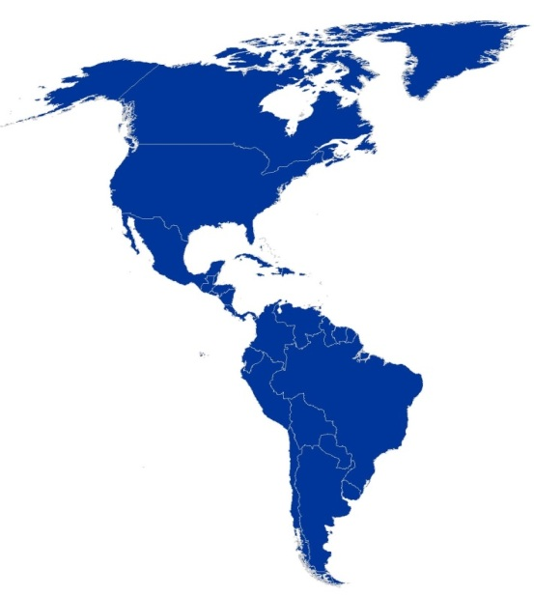
Regional mapping of the regulation of medical devices
Objective: to know the situation of the regulation of medical devices in the Region.
Argentina
Brasil
Canada
Chile
Colombia
Costa Rica
Cuba
Ecuador
Honduras
Mexico
Panama
Peru
Dominican Rep.
Uruguay
14 countries
54%
Population in the Americas
Medical Devices Regulation structure
Legislation
Regulation for the manufacturers of medical devices
Organizational structure of the regulatory authorities
Health risks communication
Incorporation of new technologies and adquisition
45 questions
630 answers
6 categories

Slide 5
Regulation structure
Incorporation of new technologies
Legislation
Proposal approved in the Cuba meeting-2012
Mapping
Preliminry results presented in Argentina- 2013
Mapping
Communication of health risks
Regulation for manufacturer
Organizational structure of the regulatory authority
Next step: indicators

Slide 6
Some Results
93%
24%
64%
Have some kind of medical devices regulation
Specific regulation for medical equipments
Marketing authorization for 100% of the devices
85%
50%
93%
Have registration of the manufacturers
Quality controls only after receiving reports
Have post marketing surveillance programs
43%
64%
Have stretegic alliances with other institutions for the strengthening of the regulatory capacity
Continuous capacity building programs for those working on medical devices

Slide 7
Structure of the Medical Devices Regulation
Legislation
Incorporation of new technologies and acquisition
Regulation of the manufacturers

