Slide 1
An introduction to the switch from trivalent to bivalent oral polio vaccines
February 2015

Slide 2
Contents
Rationale for OPV withdrawal
Timelines for switching from tOPV to bOPV
Programmatic implications of the switch

Slide 3
Children paralyzed by polio
Type 2 polio eradicated (WPV)

Slide 4
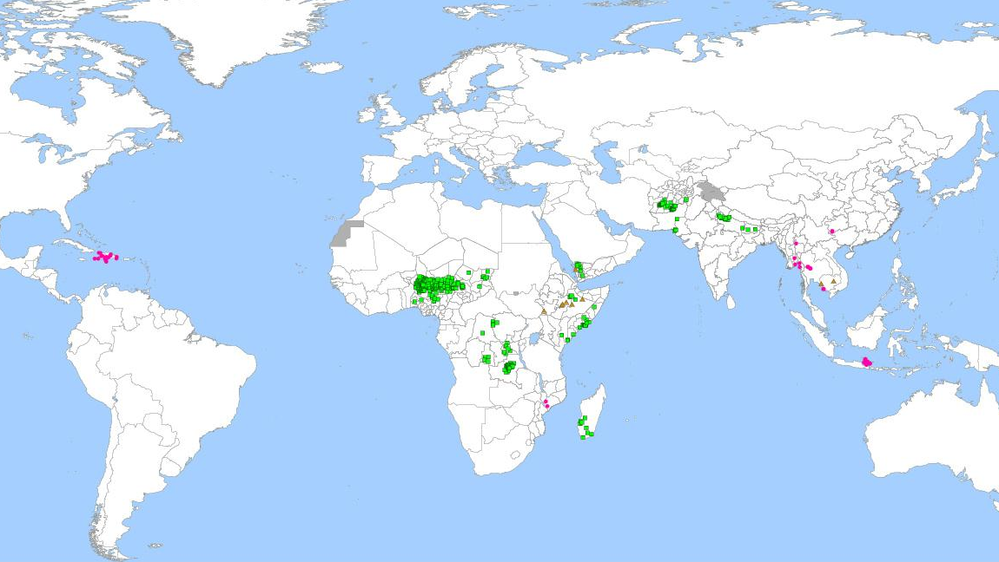
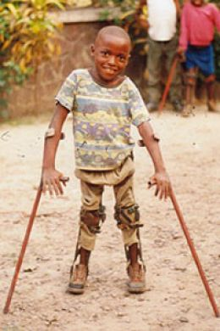
Vaccine-derived polio outbreaks (circulating VDPVs) 2000-2013
Type 1 (79 cases)
Type 2 (478 cases)
Type 3 (9 cases)
Type 1
Type 2
Type 3

Slide 5
World Health Assembly resolution 65.5
“Declares polio eradication a programmatic emergency for global public health...
…“urges the Director General to rapidly finalize a polio endgame plan…
“…and inform Member States of the potential timing of a switch from trivalent to bivalent OPV for all routine immunization programmes”
(May 2012)

Slide 6
Coming dates for the Endgame Plan
May 2015 | World Health Assembly to consider resolution on the switch
December 2015 | At least 1 dose of IPV introduced into routine immunization programmes in all countries
April 2016 | Withdraw type 2 OPV globally
2020? | After all wild polioviruses have been fully eradicated, withdraw all OPVs

Slide 7
Rationale for switching from trivalent OPV to bivalent OPV
Currently, the risks associated with the type 2 component of tOPV outweigh the benefits
Since 1999, type 2 wild poliovirus has not been detected
The type 2 component of tOPV:
Causes more than 90% of vaccine-derived polio viruses (VDPVs)
Causes approx. 40% of vaccine-associated paralytic polio (VAPP) cases
Interferes with the immune response to poliovirus types 1 and 3 in tOPV
IPV introduction will help to:
Reduce risks associated with the withdrawal of OPV type 2
Facilitate interruption of transmission with the use of monovalent OPV type 2 in the case of outbreaks
Hasten eradication by boosting immunity to poliovirus types 1 and 3

Slide 8
Contents
Rationale for OPV withdrawal
Timelines for switching from tOPV to bOPV
Programmatic implications of the switch

Slide 9
Milestones towards the switch
May 2015, World Health Assembly (WHA):
Discussion on progress and timelines towards OPV2 withdrawal in April 2016
As proposed by the WHO Executive Board in January 2015, the WHA may consider a resolution calling on member states to implement the switch
October 2015, Strategic Advisory Group of Experts (SAGE):
SAGE will review and decide on final risk assessment data to determine if the trigger for OPV2 withdrawal has been met
Trigger for OPV2 withdrawal: global absence of cVDPV2s that are known to have been circulating for more than 6 months ("persistent" cVDPV2s)
If SAGE confirms that the trigger has been met, GPEI will announce the 2016 switch dates
Once the decision to proceed with the switch in 2016 is announced, it is irrevocable. The switch will not be postponed after that date
However, if the trigger condition is not met in September 2015, the switch will be reassessed and may be postponed until 2017

Slide 10
General steps for the switch
World Health Assembly in May to consider:
Readiness criteria
IPV is introduced in all countries by end 2015
Absence of all ‘persistent’ cVDPV2s globally
Synchronized switch
WPV2 global eradication is verified
Replace tOPV with bOPV globally in a 2-week span
Phase 1 containment activities are completed, with appropriate handling of residual type 2 materials
bOPV is licensed for routine immunization
Surveillance and response capacity are implemented for WPV2 detection, and a type 2 monovalent OPV stockpile set up
No use of tOPV after this period
Trigger
SAGE in October to consider:

Slide 11
Switch window example: April 2016 in a country
e.g. National
Switch Day:
stop tOPV use
e.g. National Validation Day:
all tOPV disposed
Global Validation Day
disposal and validation
2-week window
week 1 week 2
week 3
week 4
Global switch
2-week window
The country selects a ‘National Switch Day’ from this window
Global validation 2-week window

Slide 12
Global synchronization and planning
To minimize the risk of any type 2 cVDPV re-emergence or outbreaks from the use of tOPV, the switch will need to take place everywhere worldwide within a 2-week period.
Implications for tOPV supply planning:
tOPV stocks needed for national routine immunization only until March 2016
Countries should coordinate with their relevant supplier to plan around the switch
The last in-country distribution of tOPV should take place 4 weeks before the switch date
Important to avoid tOPV stock-outs in the weeks before the switch
Countries should enhance stock monitoring and management capacity starting in 2015
Implications for bOPV:
3-6 months of supplies of bOPV should be planned for and received in countries from January 2016 onwards
New bOPV stocks should be kept at central level, stored separately until distribution
Supply may be distributed to vaccination points starting 2 weeks before the national switch date
Countries should not switch before the global switch window.

Slide 13
Contents
Rationale for OPV withdrawal
Timelines for switching from tOPV to bOPV
Programmatic implications of the switch

Slide 14
Mitigating risks before the switch
High population immunity is necessary for successful OPV cessation, to help reduce the risks of cVDPV emergence
Higher risk countries will conduct tOPV SIAs in Q4 2015 and Q1 2016, at national and/or subnational level
The plan for risk mitigation SIAs was discussed and agreed by SAGE in October 2014.

Slide 15
Principles of tOPV withdrawal
Requires a complete global replacement of tOPV by bOPV
Overall process steps: switch → recall → dispose → validate
Switch: tOPV is removed from the (private and public sector) cold chain and replaced with bOPV on the National Switch Date
Recall: tOPV is transported to collection points
Dispose: tOPV stocks are safely disposed
Validate: national and international monitors supervise the process and validate the complete absence of tOPV stock on National Validation Day (2 weeks after National Switch Date)
Manufacturers will not supply any more tOPV starting a short period before the switch.

Slide 16
Country level considerations
Planning and management
Now: Forecast quantities for supply and procurement of bOPV and tOPV
Coordinate with national committees and private sector, for both routine immunization and supplemental campaigns
Develop a national operational plan by mid 2015
Regulatory
Initiate process for national licensure of bOPV licensure (in countries that require it)
Note that bOPV is the same as tOPV for volume, heat sensitivity, VVM, and wastage
Implementation, monitoring, logistics, communication
Establish a ‘switch support team’ to implement the plan
Adapt workplans, communication and training materials to local context and language
Update data tools
Update information systems to monitor activities at all levels

Slide 17
Preparation underway at a global level
Involving vaccine manufacturers and national regulatory authorities on bOPV licensure and supply. Consulting on presentations and labelling
Developing procurement and distribution strategies to minimize stocks of tOPV while avoiding stockouts prior to the switch date, including with self-procuring countries
Developing and disseminating Switch protocol templates, workplans, communication and training materials
Seeking endorsement of the switch by WHO member states through an expected World Health Assembly discussion in May 2015
Establishing monitoring systems at all levels to track progress

Slide 18
Next steps for switch planning and communications
Switch implementation working group (under the IMG)
Coordinating planning, preparations, and technical assistance.
Communications and training
Disseminating information and hosting webinars from Q1 2015 to inform planning and developing materials for health worker training
The Switch Protocol: an implementation guide
The Protocol will be published in early 2015
Regional briefings/trainings will help build awareness and capacity
Liaison with UNICEF country offices and relevant manufacturers for self-procuring countries vital to implementation and supply strategies
Countries will be responsible for monitoring stock levels and adjusting the frequency and/or quantities of tOPV deliveries to minimize risk of excess stocks and stock-outs at country level.
Country pilot exercises will help refine preparations, guidance, and information collection systems

Slide 19
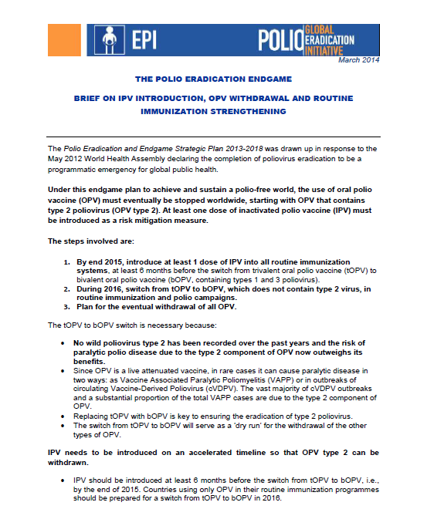
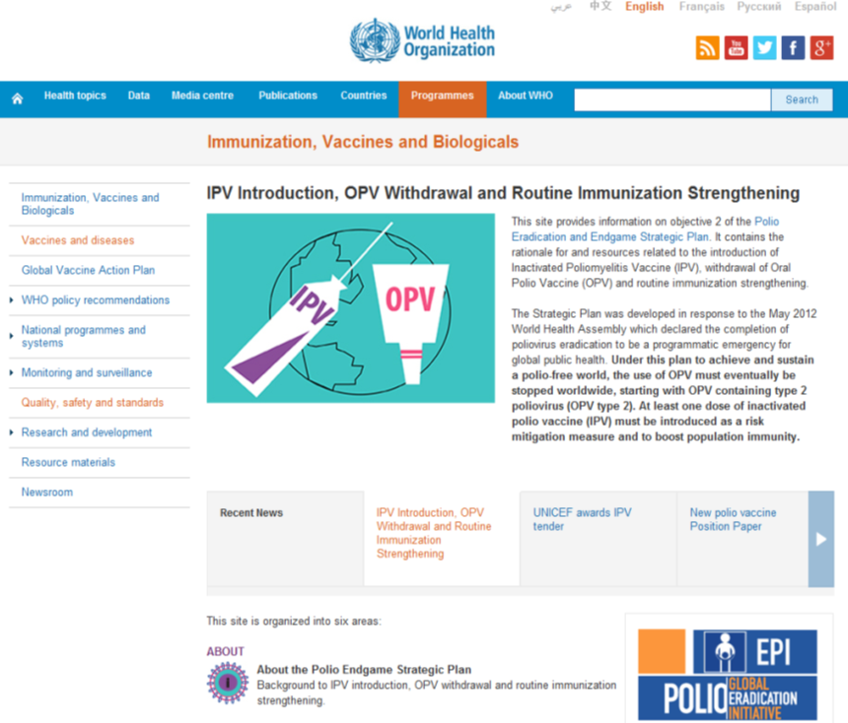
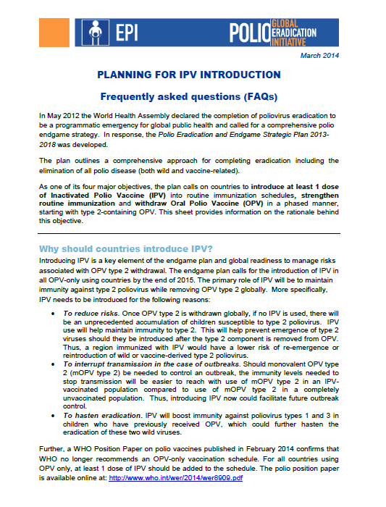
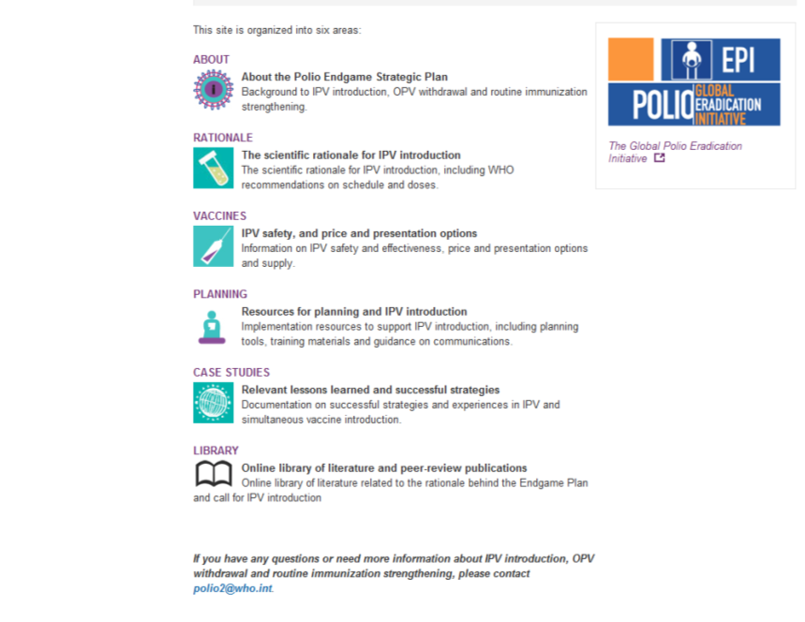
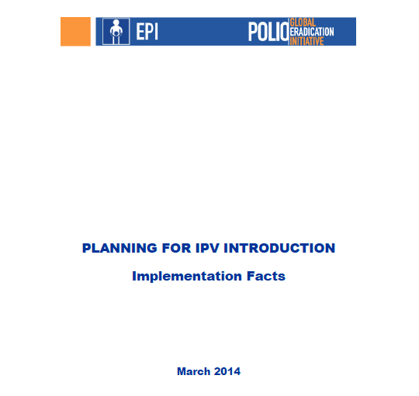
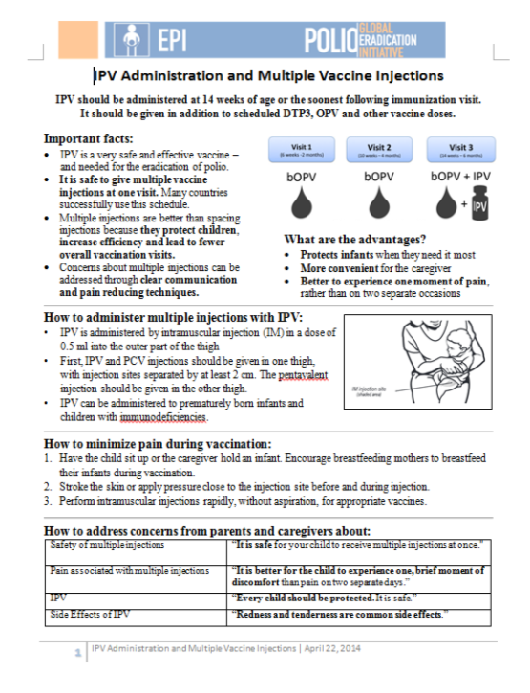
COMING SOON!
OPV technical background, communications and training materials:
http://www.who.int/immunization/diseases/poliomyelitis/endgame_objective2/en/

Slide 20
THANK YOU
For more information:
http://www.who.int/immunization/diseases/poliomyelitis/endgame_objective2/en/

