Slide 1
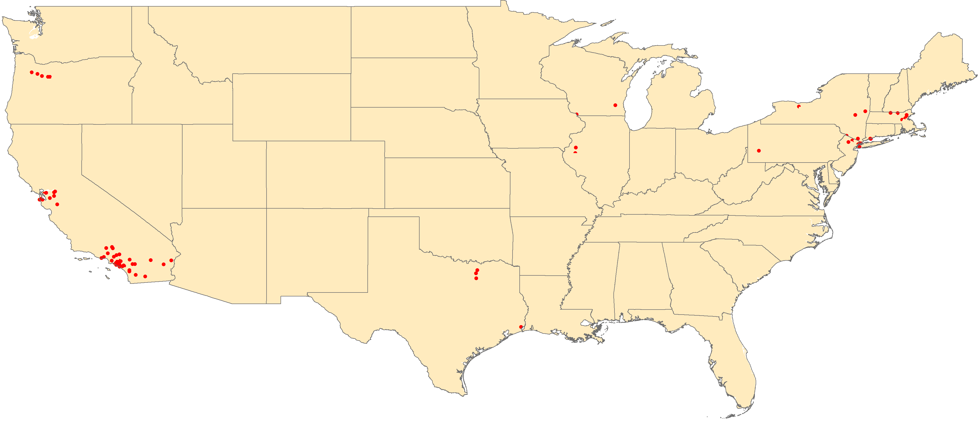
Number of confirmed measles cases
United States of America, 2014*
Massachusetts
6 cases
Wisconsin
2 cases
New York
28 cases
Oregon
5 cases
Pennsylvania
1 case
Connecticut
2 cases
Illinois
2 cases
New Jersey
2 cases
California
50 cases
Texas
4 cases
Hawaii
2 cases
2014
N=104 confirmed cases
1 dot = 1 case
* Preliminary data as of 2 April 2014
Source: CDC to FGL-IM/PAHO.

