Slide 1
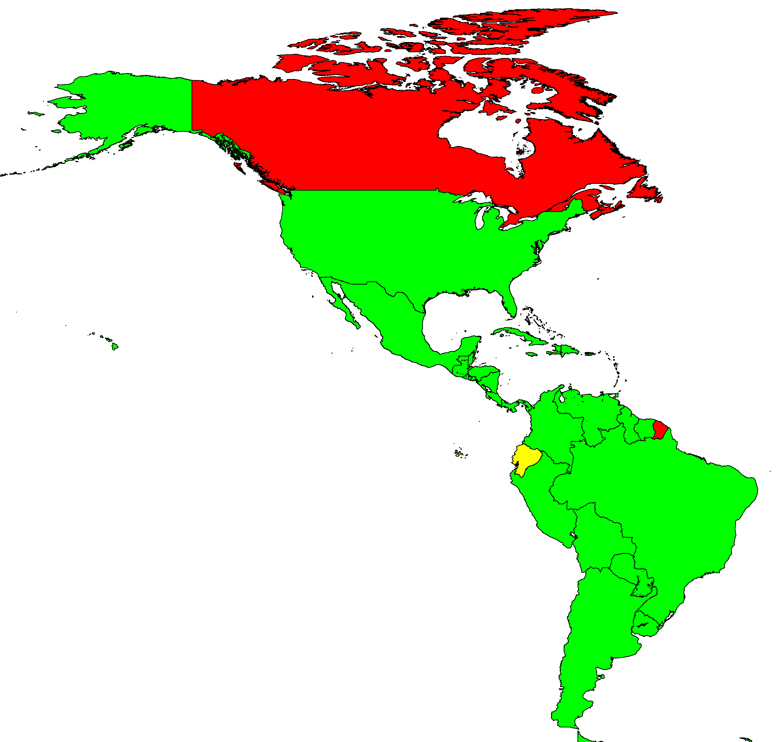
Rate of Confirmed Measles Cases per 100,000 population,
the Americas, 2011
Rate per 100,000 population
<1
1
≥2
Total number of confirmed measles cases = 346
Source: MESS, ISIS and country reports to PAHO/WHO.

