Slide 1
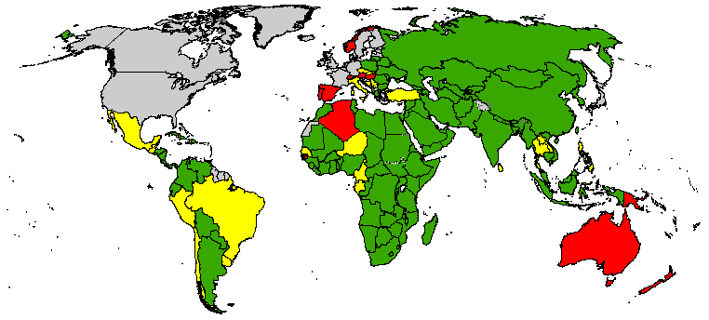
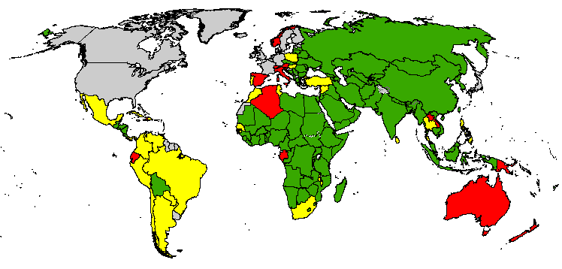
Adequate Stool Collection Percentage
Feb. 2012 – Jan. 2013
Feb. 2013 – Jan. 2014
< 60%
60% - 79.99%
> 80%
No AFP Surveillance/data
Data as of 8 Apr 2014
Source: WHO
The boundaries and names shown and the designations used on this map do not imply the expression of any opinion whatsoever on the part of the World Health Organization concerning the legal status of any country, territory, city or area or of its authorities, or concerning the delimitation of its frontiers or boundaries. Dotted lines on maps represent approximate border lines for which there may not yet be full agreement.
© WHO 2013. All rights reserved

