Slide 1
Economic and development dimensions of NCDs
A presentation of the paper:
Economic Development and Non-Communicable Chronic Diseases, published in the Global Economy Journal
Mayer-Foulkes, David
Pescetto-Villouta, Claudia.

Slide 2
Objective of this paper:
To analyze NCDs from an
economic perspective

Slide 3
NCD as an economic sickness
Main NCD risk factors are manmade:
alcohol, tobacco, junk food, lack of exercise
hence NCDs result from individual and collective decisions
We analyze the broad characteristics of the demand and supply of NCD risk factors
Then we analyze the broad impact on society, in particular on economic development

Slide 4
Economic analysis of the sickness: the key concepts
Unwholesome goods (bienes malsanos)
Demand and supply
irrationality
market power
political economy
Human development

Slide 5
The sickness

Slide 6
Main NCD factors are largely preventable
poor diet
tobacco
alcohol
salt
low exercise
NCD

Slide 7
Unwholesome goods

Slide 8
NCD Factors (outside the health sector)
Non Health Input Sectors | Examples of non-Health-Sector NCD Factors
Unwholesome Sector | Unwholesome food, including unwholesome baby food, alcohol, tobacco
Unwholesome Externalities | Work and urban living externalities, physical inactivity, pollution
Wholesome Non-health Sector | Healthy food, housing, exercise, sanitation, household health knowledge

Slide 9
Demand of unwholesome goods non-rationality

Slide 10
Supply of unwholesome goods market power, political economy

Slide 11
Supply of unwholesome goods: global market power and political economy

Slide 12
Equilibrium Distortions in Unwholesome Economy

Slide 13
the impact

Slide 14
Human Development
Long-term process of synergism between technological and physiological improvements, technophysio evolution (Fogel, 2002)
Intergenerational feedback between the lifecycle and technological and social change
Characterized by poverty trap mechanisms (life isn’t perfect!)

Slide 15
Human Development

Slide 16
Wholesome and Unwholesome Human Development

Slide 17
Stylized Impact of NCD on life cycle health, education, income and costs
NCD costs include: health care costs, disease burden (e.g. disability-adjusted life years), education, income, overall human development

Slide 18
NCD impacts work through intergenerational and life cycle links

Slide 19
Additional costs: health sector
Vaccinations, nutrition complements
Medical prevention, screening, information campaigns
Medical treatment, health insurance
Administrative and surveillance capabilities, health knowledge and technology

Slide 20
comment on universal health care

Slide 21
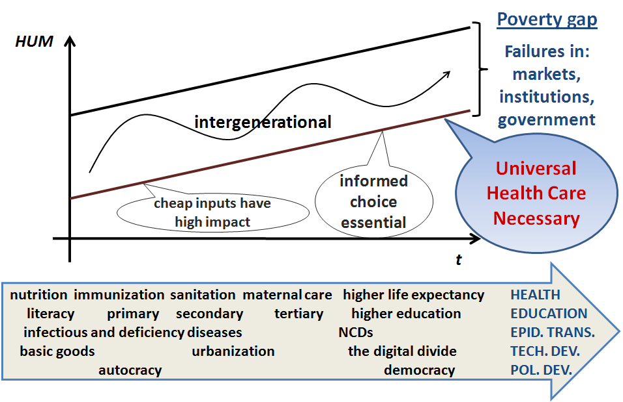
Universal Health Care is part of Human Development

Slide 22
Conclusions
NCDs can be understood as a social sickness driven by bad social/collective and individual choices in unwholesome living
These are partly kept in place by profit making
market power and political economy impacts on type and level of production in wholesome, unwholesome, and health sectors
NCDs deeply impacts human development
Healthy food initiative for the Americas
Full policy evaluation is complex and needs to be implemented simultaneously with policy measures

