Slide 1
VII Conference of the Pan American Network on
Drug Regulatory Harmonization (PANDRH)
Ottawa, Canada, 5-7 September 2013
Overview of African Medicines Registration Harmonization Initiative (AMRH)
Dr Samvel Azatyan
Manager
Medicines Regulatory Support Programme
Quality Assurance and Safety: Medicines Essential Medicines and Medical Products
World Health Organization E-mail: azatyans@who.int

Slide 2
Current challenges in Africa
In many African countries most essential medicines are not readily available and accessible due to insufficient regulatory capacity and a lack of harmonized technical requirements for medicines registration;
Poor uptake of new and existing health solutions costs millions of lives across low-income countries;
Lack of essential medicines contributes to disparities in health and life-expectancy between low-income African countries and high-income countries outside the continent.

Slide 3
Differences in regulatory capacity in WHO African Region
Medicines Regulatory capacity in 46 WHO AFRO
Member States:
Due to chronic shortages of human, technical, financial and other resources many National Medicines Regulatory Authorities (NMRAs) in Africa don't have the full capacity to perform most core regulatory functions
Source: WHO/AFRO/EDP/04.5: Availability of Drug Regulatory and Quality Assurance Elements in Member States of the WHO African Region, 2004, Brazzaville.

Slide 4
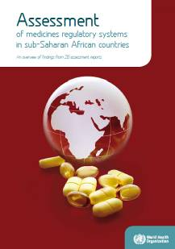
Assessments of medicines regulatory systems in 26 Sub-Saharan African countries
Guidelines and assessment procedures are not up to international standards and are often of an administrative rather than technical nature;
Wide-ranging exemption clauses exist which are not justified by a risk assessment, for example for public sector imports or donations;
Inadequate resources severely limit technical assessment of dossiers;
In spite of resource constraints only few countries rely/refer on decisions made by other regulators (such as stringent NMRAs or by the WHO Prequalification Programme), or by other competent authorities.

Slide 5
How could medicines registration processes in Africa be improved?

Slide 6
Potential public health gains from collaboration and harmonization
Less risk of being harmed by medicines, as gradual improvement of quality, safety and efficacy of products on the markets is expected;
More rapid access to needed medicines - high priority essential medicines, new medicines;
Better value for money - both for out of pocket and public funds, as there will be no waste on substandard and on poor-quality medicines.

Slide 7
African Medicines Registration Harmonization Initiative (AMRH) – a Consortium of partners (1)
Consortium Partners
Other Stakeholders
Consortium and major
stakeholders convened in
February and November
2009
NMRA Representatives
COHRED
Regional Economic Communities and Organizations (RECs)

Slide 8
African Medicines Registration Harmonization Initiative (AMRH) – a Consortium of partners (2)
Consortium confirmed its interest in supporting RECs to harmonize medicines registration and invited RECs to submit summary project proposals (SPPs) focusing on the immediate steps needed to promote regional drug registration harmonization;
Consortium reviewed the SPPs and identified those to recommended for development into full project proposals, and those for which further work is required;
A concrete outcome of the Consortium's efforts was the development of a fundable medicine regulatory harmonization project for the East African Community (EAC);
A Multi-Donor Trust Fund established under the World Bank (WB) to fund the project activities by all Consortium partners.

Slide 9
African Medicines Registration Harmonization Initiative (AMRH) – a Consortium of partners (3)
The overall objective of this project is to achieve a harmonized medicines registration process in countries belonging to the Regional Economic Communities (RECs), based on common documents, processes and shared information systems at the level of Regional Economic Communities (RECs).
WHO role in the project is:
To provide technical assistance in development and implementation of harmonized approaches for registration of medicines;
Support Technical Working Groups in 4 areas: Medicines Evaluation and Registration, Good Manufacturing Practices (GMP), Information management systems (IMS) and Quality Management System (QMS);
Support capacity building, training and joint activities.
Chairing the Technical Working Group on Regulatory Capacity Development in Africa.

Slide 10
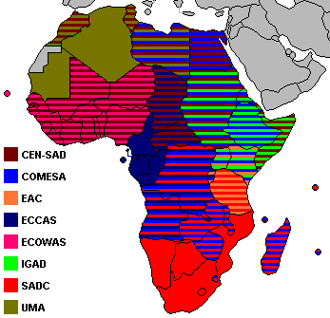
Why Regional Economic Communities (RECs) ‐ based approach?
Africa is a continent of huge diversity and complex unity, with numerous Regional Economic Communities (RECs);
RECs have a strong mandate to promote common trade, economic and market opportunities to those countries that constitute their member states.
In addition to economic development, many RECs work to promote social development and are increasingly active in the healthcare field.
Several RECs have already supported harmonization of medicines registration by developing common pharmaceutical policies and operational plans.

Slide 11
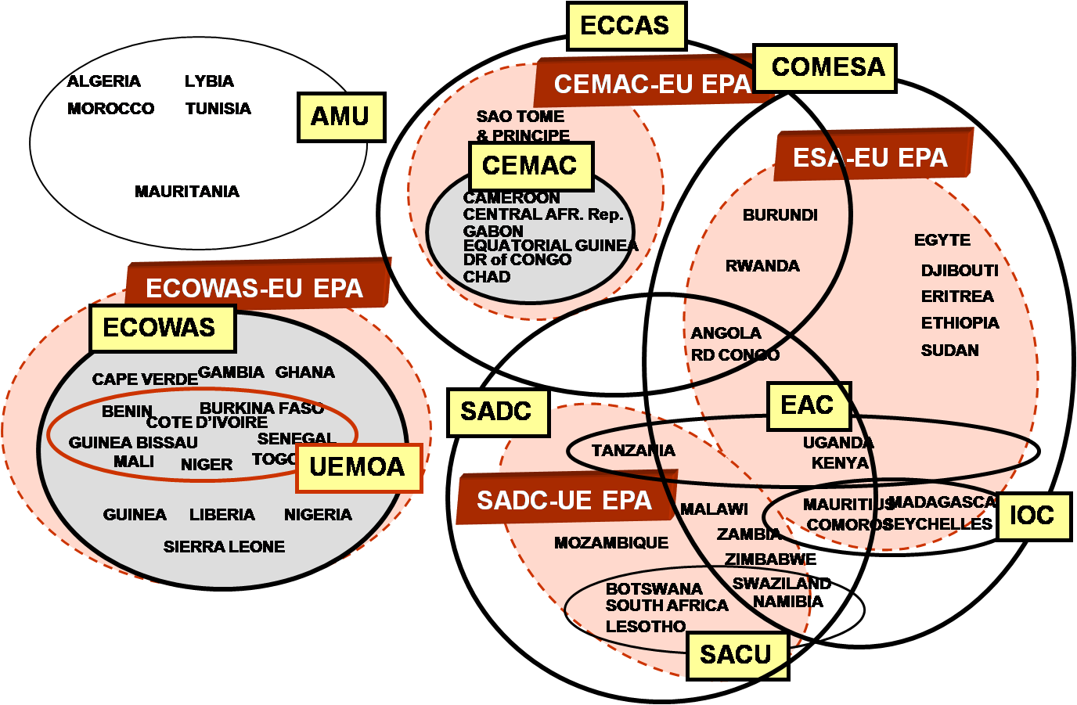
Why Regional Economic Communities (RECs) ‐ based approach?
But.. a number of overlaps and politically complicated environment substantially affect the situation…

Slide 12
Almost 85% of Sub-Saharan Africa covered by Summary Project Proposals already completed or in the process
REC progress
Completed or in-process RECs | Countries covered | Total members* | % pop covered
EAC & OCEAC EAC, OCEAC, ECOWAS EAC, OCEAC, ECOWAS, SADC | 12 (20%) 26 (46%) 41 (74%) | 11 26 41 | 17% 45% 72%
*Tanzania in both EAC and SADC (but will go with EAC); UEMOA/ECOWAS are working out overlap
WAHO/UEMOA
EAC
OCEAC
WHO, NEPAD and World Bank:
supporting East African Community which has already received funding and is implementing the project;
continuing to work with other RECs to finalize their proposals.
SADC
Source: BCG analysis
12

Slide 13
East African Community is progressing in the implementation of EAC MRH (1)
TWG on Medicines Evaluation and Registration:
final draft of the EAC guidelines on format and content of labels for medicinal products;
final draft of the EAC guidelines on the format and content of patient information leaflet (PIL) for Medicinal Products;
final draft of the EAC guidelines on the format and content of summary of product characteristics for medicinal products (SmPC);
final draft of the EAC Guidelines on Stability requirements;
final draft of the EAC Application Form for registration of human medicines.
TWG on Good Manufacturing Practices (GMP):
finalizing the EAC GMP Format for Executive Summary;
finalizing EAC GMP Inspection Manual;
finalising EAC Inspection preparation Standard Operating procedures (SOP);
finalising EAC GMP Report Format;
finalising EAC GMP Report Writing Format;
finalising SOP for conducting GMP inspection.

Slide 14
East African Community is progressing in the implementation of EAC MRH (2)
TWG on Information management systems (IMS):
completed final terms of reference for the consultancy to conduct an assessment of the current state of the existing IMS, to design and develop technical specifications for a harmonized IMS in the EAC Partner States National Medicines Regulatory Authorities (NMRAs) and EAC Secretariat (assessment conducted by the WHO in January 2013);
revised Terms of Reference for the technical working group on IMS;
completed draft guidelines for the development of the common information management system.
TWG on Quality Management System (QMS):
finalizing the Draft East African Community (EAC) Quality Management Requirements;
finalizing guidelines for implementation of EAC QMS requirements;
finalizing the draft EAC QMS Manual.

Slide 15
Joint activities in EAC to support national decision making
2010 – Joint WHO-EAC Pilot Assessment exercise:
2 products, submitted by one of the manufacturers simultaneously in EAC countries and in the WHO Prequalification Programme;
3 joint assessment sessions conducted during March - July 2010;
Prequalified by WHO in August 2010 – review time 4 months.
Registered by EAC NMRAs in 7 months after joint review.
2013 – 2nd Joint WHO-EAC Assessment exercise:
3 products (4 strengths) are submitted by the same manufacturer simultaneously in EAC countries and in the WHO Prequalification Programme;
First joint assessment session conducted in July 2013;
Second session is planned for September 2013..
Platform for collaboration, building trust and mutual
recognition of regulatory decisions in the future

Slide 16
What we do and don't mean under harmonization
True harmonization goes far beyond development of common documentation;
It requires effective communication and collaboration aimed at building capacity and trust (e.g., information sharing, recognition and joint activities);
In combination, these activities can lead to similar or collaborative approaches to medicines registration;
Can prepare the ground for mutual recognition and/or centralized registration in the longer-term future.

Slide 17
What we do and don't mean under harmonization
Harmonization doesn't mean a loss of national sovereignty / autonomy (and certainly not in the early stages);
In all cases the registration decision itself remains firmly in the hands of sovereign nations;
Collaborative mechanisms, such as joint assessments or inspections, does not imply collaborative decision-making!

Slide 18
Conclusions
Medicines regulation is not anymore a "single-player" activity;
Harmonization of regulatory requirements, work sharing and collaboration can help reduce workload and improve public health by improving overall regulatory performance.
It can help to direct the expert knowledge and resources to performance of the functions that can improve public health and facilitate access to essential medicines;
Formation of effective networks between regulatory authorities nationally and internationally may facilitate sharing of scarce resources and eliminate duplicating of activities.

Slide 19
Graphic: www.uneca.org
Thank you!
www.who.int/medicines

