Slide 1
Economic Dimensions of NCDs in Latin America and the Caribbean Region – Disease Control Priorities Network June 24th – 25th, 2013 Pan American Health Organization
Rachel Nugent, DCP3 Series Editor
University of Washington
Notes:
Ole Norheim: Dashboard is good but will be very difficult for policymakers to understand, so we need clear and consistent definitions across ECEAs.

Slide 2
Disease Control Priorities Network
DCP3+
DCP Country and
Region Network
Country Costing
Optimization Models
Institutional Network
UW DGH
IHME

Slide 3
Disease Control Priorities Network
DCP3+
DCP Country and
Region Network
Country Costing
Optimization Models
Institutional Network
UW DGH
IHME

Slide 4
Network Collaborations (Component 13)
South Africa - PRICELESS
Partners: NIH and University of Witwatersrand
Aim: Development of institutional capacity for priority setting
Policy targets: Immunization, diabetes, salt reduction, PMTCT
Status: permanent health economics role in policy setting
India - National
Partners: University of Toronto
Aim: Policy uptake
Policy targets: Supplementary immunization of new antigens, rotavirus CEA, HiB, pneumococcal; cancer CEA; CVD
Notes:
India – National Efforts
Choosing health book (put up a slide with a picture of the book) – part of policy uptake for DCPN
Aims to influence big policy decisions and test pathways to policy uptake
India – Bihar
Emphasis on immunizations
Emphasis on immunizations
Avertable burden
On-going collaborations and emphasis on child health immunizations – measles and antigens
Avertable burden estimates and CE estimates and looking at policy instruments of increasing uptake; interim evaluation of what has been done on measles (fed sponsored effort)

Slide 5
Country Collaborations (Component 13)
India – Bihar, Karnataka
Partner: Partners: University of Toronto
Aim: Cost effectiveness of interventions for improving child health
Policy targets: Expanded coverage and new antigen use in immunization, cost of essential package
Rwanda
Potential Partners: Partners in Health and Rwanda MoH, NUR SPH
Aim: Capacity-building for economic analysis, NCD platform cost effectiveness
Policy targets: CHWs, NCDs, TBD
Notes:
India – Bihar
Emphasis on immunizations
Emphasis on immunizations
Avertable burden
On-going collaborations and emphasis on child health immunizations – measles and antigens
Avertable burden estimates and CE estimates and looking at policy instruments of increasing uptake; interim evaluation of what has been done on measles (fed sponsored effort)

Slide 6
Regional Collaborations
WHO- PAHO
Partner: Deputy Director, ProVac, NCD team
Aim: Capacity building and methods development for economic analysis and policy influence
Policy targets: Immunization and NCDs
WHO-EMRO
Partner: Ala Alwan, EMRO Regional Director
Aim: Produce economic evaluations and policy guidance document
Policy targets: NCD economic analysis, priority-setting

Slide 7
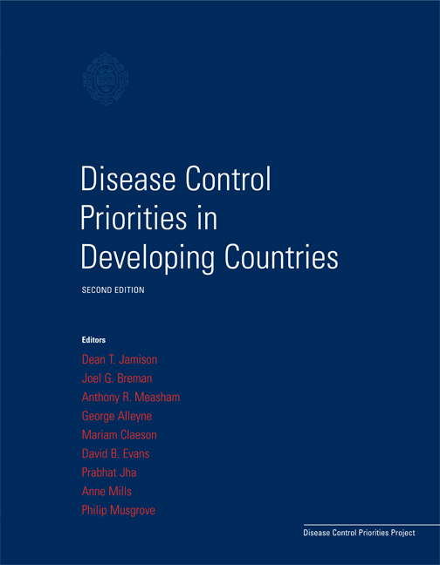
DCP2

Slide 8
DCP2 by the Numbers
2 Number of books
4 Number of years
13 Number of editors
78 Number of chapters
350 Number of authors

Slide 9
Disease Control Priorities, 3rd Edition
9 Number of volumes
5 Number of years
30 Number of editors
155 Number of chapters
400 Number of authors

Slide 10
Disease Control Priorities, 3rd Edition
DCP3 Volume Topics
Disease Control Priorities in Developing Countries
2. Reproductive, Maternal, Newborn and Child Health
3. Child and Adolescent Development
4. AIDS, STIs, TB and Malaria
5. Cardio-metabolic and Respiratory Diseases
6. Cancer
7. Environmental Health and Injury Prevention
8. Mental, Neurological and Substance Use Disorders
9. Essential Surgery

Slide 11
Production Timeline
2013/14
2014/15
2014/15
2014/16
Writing of chapters, web publication
Editing and peer-led review
Volume production
Dissemination

Slide 12
Objectives of DCP3
Inform allocation of resources across interventions and health service delivery platforms.
Provide a comprehensive review of the efficacy and effectiveness of priority health interventions.
Advance knowledge and practice of analytical methods for economic evaluation of health interventions.

Slide 13
Economic Analysis
Extended cost-effectiveness analysis (ECEA) Assess distributional and financial protection consequences of policy choices affecting access, uptake and quality of interventions and delivery platforms.
Benefit-Cost Analysis (BCA) Evaluate policies beyond the health sector.
Costing Information gathering on cost and cost-effectiveness of interventions, policies and other health system resources.

Slide 14
NCD Priorities in LAC Region
What are the important policy questions?
What economic analysis is available; what is missing?
How can economists contribute to policy development?
What are the key questions that economics can contribute to --- multisectoral approach, equity impacts, financial risk protection, population prevention?

