Slide 1
Mammography Regulations and Standards in the U.S.: The Basics of the Mammography Quality Standards Act
Helen J. Barr, MD
Director, Division of Mammography Quality Standards
Center for Devices and Radiological Health
Food and Drug Administration
Department of Health and Human Services

Slide 2
MQSA
The Mammography Quality Standards Act was signed into law October 27, 1992
It required all mammography facilities to be certified by October 1, 1994, in order to legally operate
Is administered by the U.S. Food and Drug Administration ( FDA)

Slide 3
Key Features of MQSA
Implementing regulations set BASELINE QUALITY STANDARDS that all mammography facilities must meet
Requires facilities undergo ANNUAL INSPECTION against those standards
Requires mammography units at facilities be ACCREDITED by an FDA-approved body

Slide 4
Key Features of MQSA
Once accredited, a facility is CERTIFIED by FDA (or FDA-approved state), allowing it to legally perform mammography
If standards are not met, MQSA allows for COMPLIANCE AND ENFORCEMNT ACTIONS, both corrective and punitive

Slide 5
Accreditation
Each facility undergoes accreditation initially and every 3 years
Clinical and phantom images are reviewed by experts
Other QC and personnel documentation is reviewed

Slide 6
Phantom Image

Slide 7
Inspection
Each facility is inspected annually
Approximately 8,700 mammography facilities
Facilities pay an inspection fee
Inspections performed under contract with States or by FDA (90% by States)
Inspectors trained by FDA (approx. 200 active inspectors)

Slide 8
Inspection Finding Levels
Level 3 - Facility performance generally satisfactory with a minor deviation from MQSA standards (next inspection)
Level 2 - Facility performance generally acceptable with a deviation that may compromise quality (30 days)
Level 1 - Deviation that may seriously compromise quality (15 days)

Slide 9
Compliance and Enforcement
Directed Plan of Correction
Patient and Provider Notification
Follow-Up Inspection (fee based)
Certificate Revocation/ Suspension
Civil Money Penalty

Slide 10
Patient Focused Features MQSA
Requires facilities to release ORIGINAL mammograms temporarily or permanently to patient, representative, or provider
Requires patients to get WRITTEN results of mammogram in LAY LANGUAGE, in addition to health care providers’ medical report
Establishes TIME FRAMES for communicating results to patients and health care providers

Slide 11
Patient Focused Features MQSA
Requires CERTIFICATE to be prominently displayed so that patients know facility has met quality standards
Requires annual PUBLICALLY AVAILABLE REPORT on facility adverse events/compliance actions
Requires special training for technologists who perform mammograms on patients with IMPLANTS

Slide 12
Quality Standards
Quality Control testing and standards
Quality Assurance standards
Equipment standards
Annual Physics Survey + Equipment Evaluation
Consumer complaint mechanism
Infection control procedures
Records Retention and Release

Slide 13
Quality Standards
Personnel qualifications - Interpreting physicians, Radiologic technologists, Medical physicists (licenses and certificates; initial and continuing education and experience)
Standards for reports to referring healthcare providers and patients - assessment categories; time frames for reporting results
Medical Outcomes Audit

Slide 14
Quality Control Testing Examples

Slide 15
Personnel Qualification Examples Interpreting Physician: Initial
Licensed to practice medicine in a State
Specialty board certification or
At least 3 months of formal training mammography interpretation under direct supervision of a qualified physician
60 hours of Category I CME
Interpreted at least 240 mammograms

Slide 16
Interpreting Physician: Continuing
From the date of the end of calendar year in which the initial qualifications are met, must read at least 960 mammographic examination within 24 months period, 15 category I continuing education within 36 months
8 hours of new mammographic modality related training before providing services

Slide 17
Technologist: Initial
Licensed to perform general radiographic procedures in a State
Certified by an appropriate specialty area by a body determined by FDA
40 contact hours training in mammography
At least 25 examinations under the direct supervision of a qualified Rad Tech

Slide 18
Technologist: Continuing
From the date of the end of calendar year in which the initial qualifications are met, 15 continuing education units within 36 months
8 hours of new mammographic modality related training before providing services in a new modality

Slide 19
Medical Physicist: Initial
State approved or certified by FDA approved body
Master’s degree or higher in physical science with at least 20 hours in physics
20 contact hours in mammography
At least 1 facility and 10 mammography units survey experience

Slide 20
Medical Physicist: Continuing
From the date of the end of calendar year in which the initial qualifications are met, 15 continuing education units within 36 months, experience of surveying 2 mammographic facilities and total of 10 mammographic units
8 hours of new mammographic modality related training before providing services in a new modality

Slide 21
Information Management: MPRIS
Insures the quality, reliability, integrity, and accessibility of accreditation, certification, inspection, compliance, and billing data
Inspection reports uploaded from inspector laptops to database
Receives info from accreditation bodies and state certifiers
Sends certification data to CMS
Allows certified facility search by zip code

Slide 22
Has MQSA Been Successful?
Since MQSA, the morbidity and mortality rates of breast cancer have been decreasing about 2% per year from 2002 to 2011 (new treatments, increased awareness)
In 1975 the five-year survival rate was 75.5%. In 1990 it was 84.6%. In 2006 it was 90.6%
Between 1994 and 1996, only 76% of mammography units passed accreditation on first full attempt – currently 99%

Slide 23
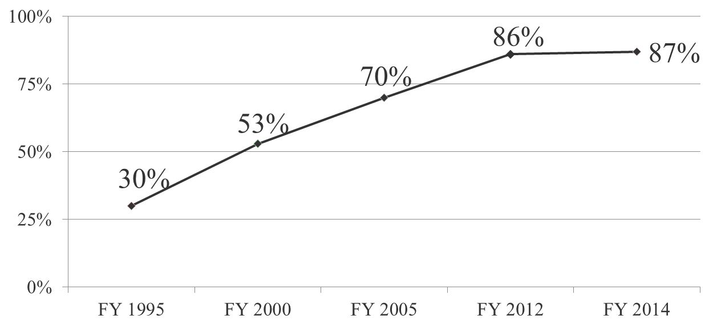
Has MQSA Been Successful? Compliance: % Violation Free
Of facilities with violations, only 0.4% have Level 1 (the most serious) violations

Slide 24
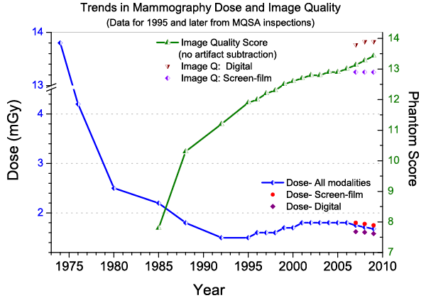
Dose and Image Quality

Slide 25
Current Statistics
Average number of mammography units per certified facility is 1.6
94% of certified facilities are now completely digital
In ten States and the Armed Forces, 100% of certified facilities are all digital
In 35 states, over 90% of certified facilities are all digital
Approximately 39 million mammograms are performed yearly in U.S.
Source: MQSA National Statistics web page (data from MPRIS)

Slide 26
Take Home Point: Mammography Is a Team Sport
Interpreting Physicians
Mammography Technologists
Medical Physicists
Other imagers: breast ultrasound; MRI
Surgeons; Pathologists
Administrators/Purchasers
Support Staff

Slide 27
More Information
MQSA Internet home page
www.fda.gov/Radiation-EmittingProducts/MammographyQualityStandardsActandProgram/default.htm
Policy Guidance Help System (PGHS)
www.fda.gov/Radiation-EmittingProducts/MammographyQualityStandardsActandProgram/Guidance/PolicyGuidanceHelpSystem/default.htm
Certified facility search by ZIP Code
www.accessdata.fda.gov/scripts/cdrh/cfdocs/cfMQSA/mqsa.cfm
MQSA Facility Hotline: 1-800-838-7715

