Slide 1
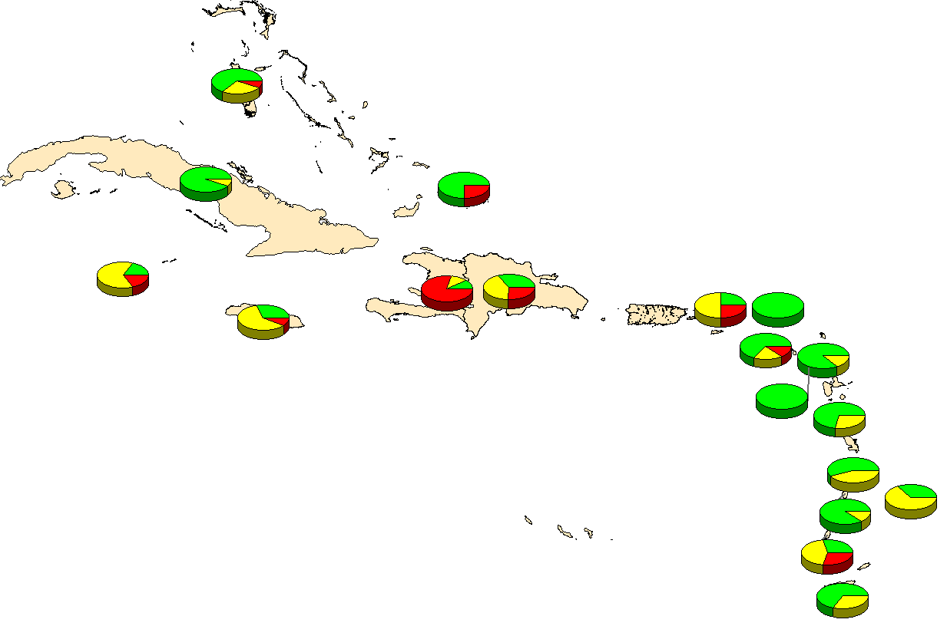
Notes:
Image: Data not available
Source: PAHO-WHO/UNICEF from PAHO-WHO/UNICEF joint reporting forms (JRF) received in 2015. Preliminary data.
11

