Slide 1
Strengthening Good Regulatory Practice based through Evaluation of Regulatory Capacity
Fortalecimiento de las Buenas Prácticas de Regulación a través de la Evaluación de la capacidad regulatoria
Miriam Naarendorp
Pharmacy Policy Coordinator & Head of the Pharmaceutical Inspectorate
Coordinadora de la Politica Farmaceutica & Jefa de la Inspeccion Farmaceutica

Slide 2
SURINAME
Notes:
Just to remind you that Suriname is part of Latin America, situated at the north coast facing the Atlantic Ocean. The land size is about 160,000 square kilometers and the population approximately 500.000 people, 80 percent of which lives in the coastal area.

Slide 3
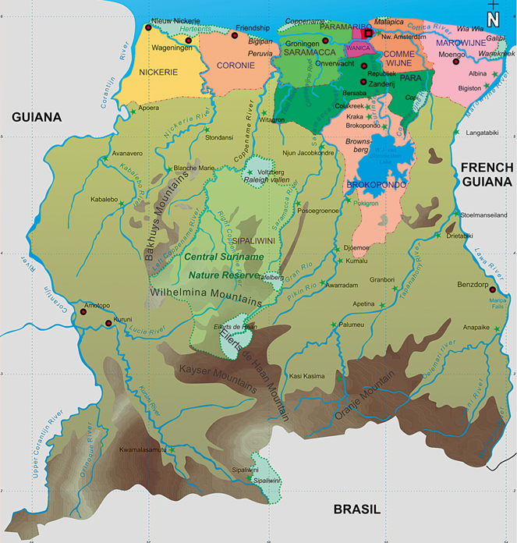
Coastal area
2 Urban districts
6 rural districts
Interior
2 interior districts
Area 163 820 Km²
Urban: 0.5%
Rural: 14.5%
Interior: 85%
Population 509,970 (2007)
Population density
Nationwide: 3 Urban: 526
Par’bo: 1335
Wanica: 194
Rural
Interior
Brokopondo: 2
Sipaliwini: 0.3

Slide 4
medicines regulatory authority
network that administers the full spectrum of medicines regulatory activities, usually at a national level, including at least the following functions and sometimes others:
Marketing authorization for new products and variation of existing authorizations;
Quality control laboratory testing;
Good Practice inspections/audits and licensing of manufacturers, wholesalers, other distribution channels, clinical trial centres, and Laboratories responsible for quality control and toxicology testing;
Adverse drug reaction monitoring (pharmacovigilance);
Provision of medicines information and promotion of rational use of medicines;
Control of promotion and advertising;
Monitoring of Medicines Utilization;
Enforcement operations

Slide 5
Suriname regulatory landscape
Activity | Regulated | Laboratory Support | Legislation avalable | Comment
Medicines | yes | yes | yes | outdated/ certain components lacking or not enacted/ new framework available; pharmaceutical starting materials are not specifically regulated
Food | yes | yes | yes | outdated/ certain components lacking or not enacted/ new concept available
Medical products | No | no | yes (partially) | Bureau of Standards is partially tasked with the development of this component
Blood | yes | yes | Yes | New legislation recently approved (2012)
Cosmetics | no | yes | no | Lab support based on specific post marketing requests
Sanitizers | no | yes | no | Incidently in hospitals effectiveness of sanitizers has been analyzed
Tobacco | yes | no | Yes | New legislation recently approved (2013)
Pesticides | yes | yes | yes | Mandate of Min. Agriculture

Slide 6
Prior work and national environment
National Medicines Policy with QA expanded policy (2010)
National HERA consultancy
Participation in Caricom HERA consultancy
Development of the CPP
Member of TECHPHARM
Alternate member Steering ctee for CARICOM
Member UNASUR GAUMU

Slide 7
Areas of Activity MOH & institutions
Pharmaceutical Quality
Established in the NMP/ (expanded) QA policy
Current areas of activities
Registration of medicines
Pharmaceutical Inspection
Pharmaceutical Laboratory (Part of PAHO network)
(Pharmacovigilance was initiated but not sustained/ lack of HR)
Areas that are lacking have been identified and documented (ie inspection capacity; regulatory standards etc)
PAHO evaluation contributed to specifying and quantifying gaps

Slide 8
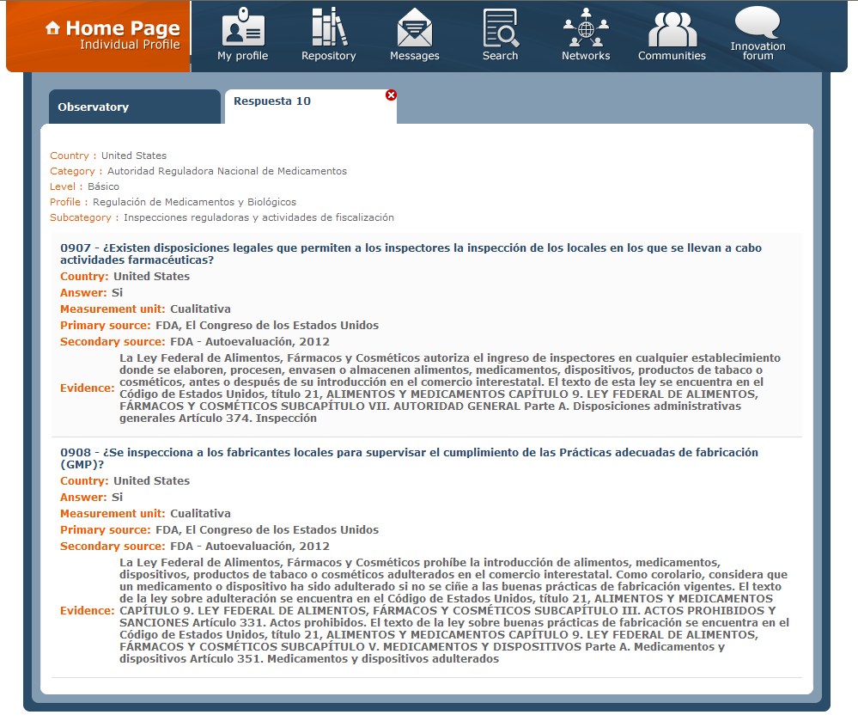
20 Basic regulatory Indicators (public information)
Observatory
Provides information on the sectors and processes involved in development, production, and regulation of health technologies through the use of standardized indicators that are updated periodically

Slide 9
Preevaluation Data Tool
I = implemented
OI = Ongoing implementation
PI = Partially implemented
NI = Not implemented
NA = Not applicabe
530 Indicators
NRA Qualification Process
166 Indicators
NRA Pre-Qualification Process
20 Indicators
NRA Pharmaceutical
Profile
Information Hub
Regulatory Module

Slide 10
Modules
Module 1. National Regulatory Authority (NRA)
Module 2. Marketing Authorization (MA)
Module 3. Licensing of Manufacturers
Module 4. Market Monitoring
Module 5. Pharmacovigilance
Module 6. Control of Clinical Trials
Module 7. Regulatory Inspections and Enforcement Activities
Module 8. National Quality Control Laboratory
Module 9. Lot Release for vaccines

Slide 11
166 Advanced regulatory Indicators (Restricted access among NRA)
Observatory
Some inspections indicators as an example

Slide 12
Evidence provided by Suriname
Modules | Interview (Persons) | Legal Framework | Official Documents | Electronic Systems
1.National Regulatory System | 2 | 3 | 4 | 2
2. Marketing Authorization | 2 | 5 | 11 | 1
3. Licensing of Manufacturers | 1 | 2 | 3 | 1
4. Market Monitoring | 2 | 2 | 8 | -
5. Pharmacovigilance | 1 | 1 | 1 | -
6. Clinical Trials | 2 | 1 | 1 | -
7. Inspections | 1 | 2 | 3 | -
8. Quality Control Laboratory | 5 | 1 | 9 | -
9. Lot Release for vaccines | 1 | 1 | 2 | -
Total | 8 | 11 | 28 | 4

Slide 13
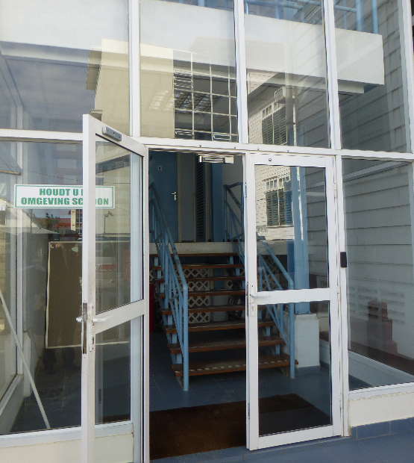
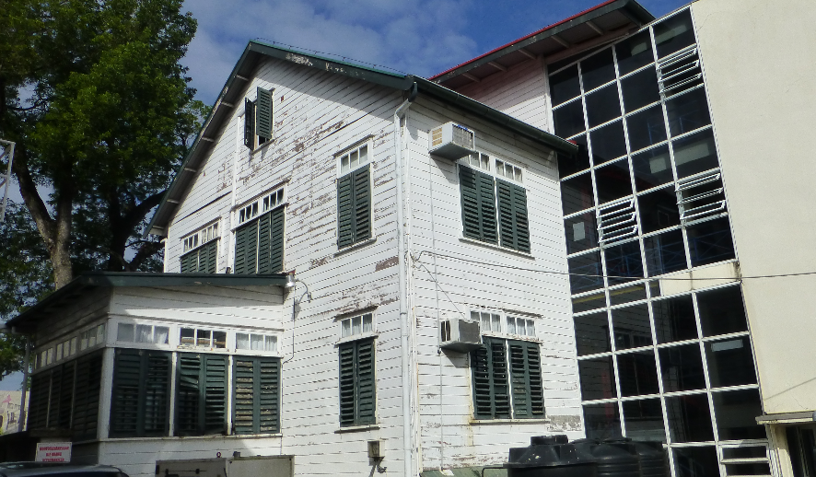
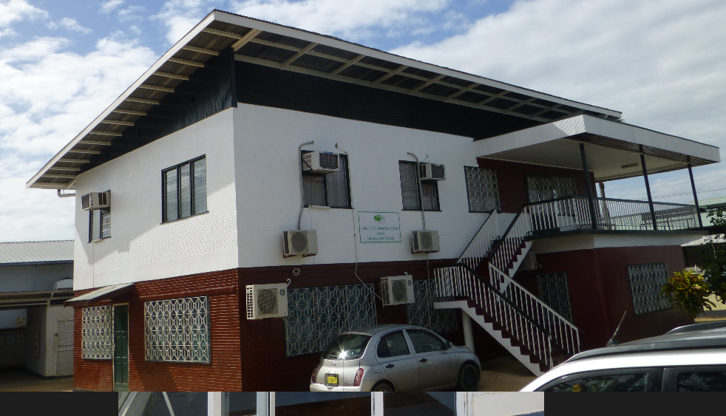
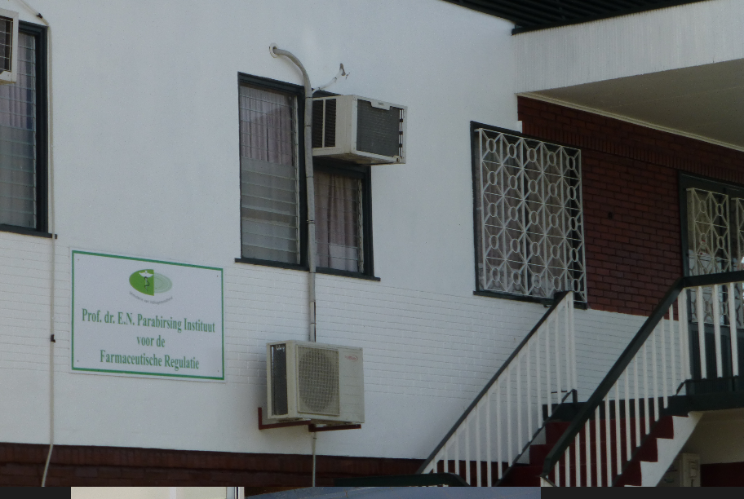
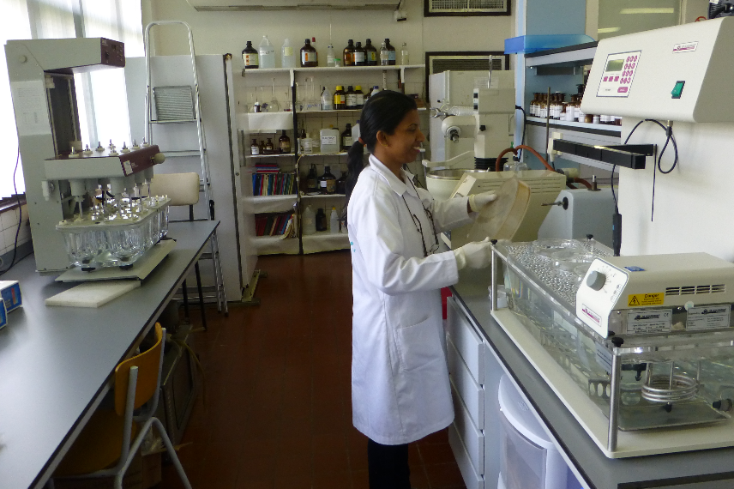
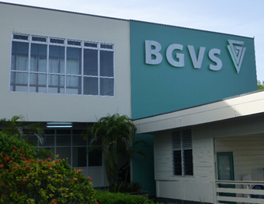
Places visited
PAHO - SUR
MoH - SUR
Prof. dr. E.N. Parabirsing Instituut voor de Farmaceutische Regulatie
Registration Committee
Quality Control Lab - BGVS

Slide 14
Preliminary results
I = implemented
OI = Ongoing implementation
PI = Partially implemented
NI = Not implemented
NA = Not applicable
≈ 25% implemented
≈ 34% Partially Implemented or ongoing implementation
≈ 41 % Not Implemented or Not Applicable

Slide 15
Key positive findings
Elements of a Regulatory System in place
Legal framework provide overall sustainability
Registry Committee well established by law and processes well documented
Inspectorate good formed
Regulatory team conscious about their role and responsibilities, and open-minded about the pre-evaluation process

Slide 16
RECOMMENDATIONS
Define the MNR System
Update legislation
Develop quality management system for documentation
Improve public communication and outreach
Create code of conduct for regulators
Enhance MA registry functionality
Develop guidance to improve MA process as Risk/Benefit assessment
Improve utilization of regulatory decisions, reports, and background information from other NRAs
Clarify different requirements for innovative and generic drugs
Plan for internal human resource development and continuing training
GMP inspection of local manufacturers and registration of local products

Slide 17
Recommendations ctd
Use of PSUR for safety monitoring
Create institutional relationship with immunization program related to AEFI
Establish guidelines for internal procedures on pharmacovigilance Risk/Benefit assessment
Establish guidelines for regulated MAH
Define guidelines for GCP
Develop official guidance for GMP activities
Implement quality management system for inspections
Develop risk-based criteria for inspections
Develop official guidance for using GxP, including training inspectors for these practices
Implementing the QMS
Code of conduct and conflict of interest

Slide 18
NRA Pre-evaluation Outputs
Assess strengths
Opportunities for improvement
Set priorities
Baseline data for monitoring
Priority intervention
Action needed
Posible improvement
Institutional Development Plan for NRA

Slide 19
Overall Recommendation
Implement Institutional Development Plan
I-Technical and Functional level
I.A. Actions to perform
Module | Indicator | Action (verb) | How | When | Why | Impact if completed | Resp.
II-CMO/Directorate Level
II.A. Actions to perform

Slide 20
Next Steps and Proposed Timeline
End August - Formalize Ad Hoc Group for Develop and Implement Institutional Development Plan (IDP)
End October – Draft first version of IDP to Director of Health
End November – Deliver 1st status report on IDP implementation to PAHO
Amend IDP if necessary
February 2014 – Deliver 2nd status report to PAHO
April 2014 – Conduct self-evaluation using 166 indicator tool
Amend IDP if necessary
June 2014 – Deliver 3rd status report, including results of self-evaluation
July 2014 – Complete follow up pre-evaluation by PAHO

Slide 21
DANK U WEL THANK YOU GRACIAS OBRIGADO

