Slide 1
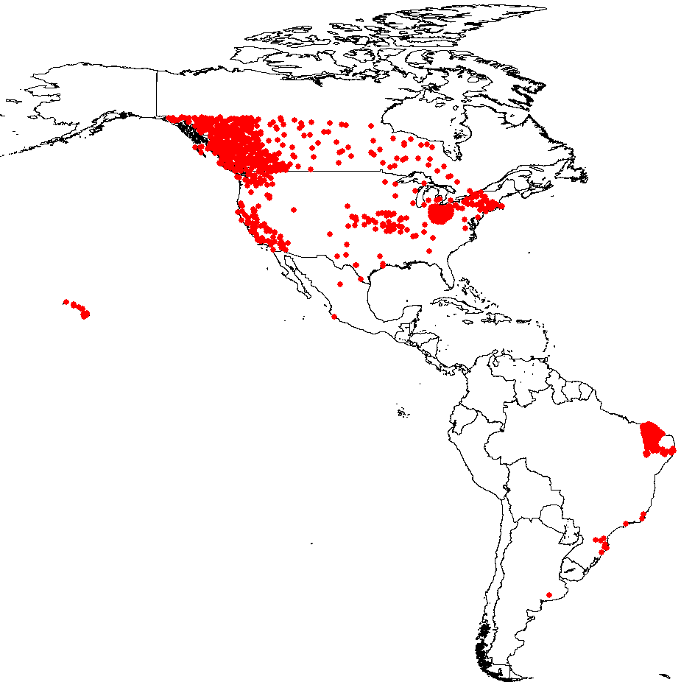
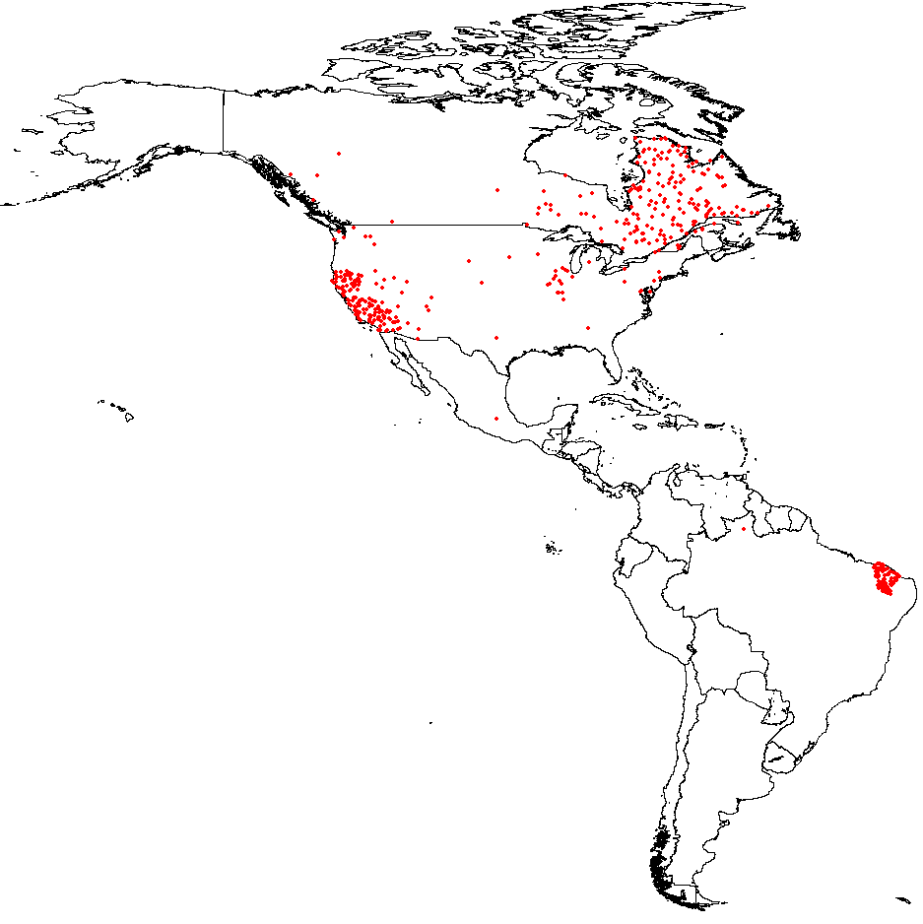
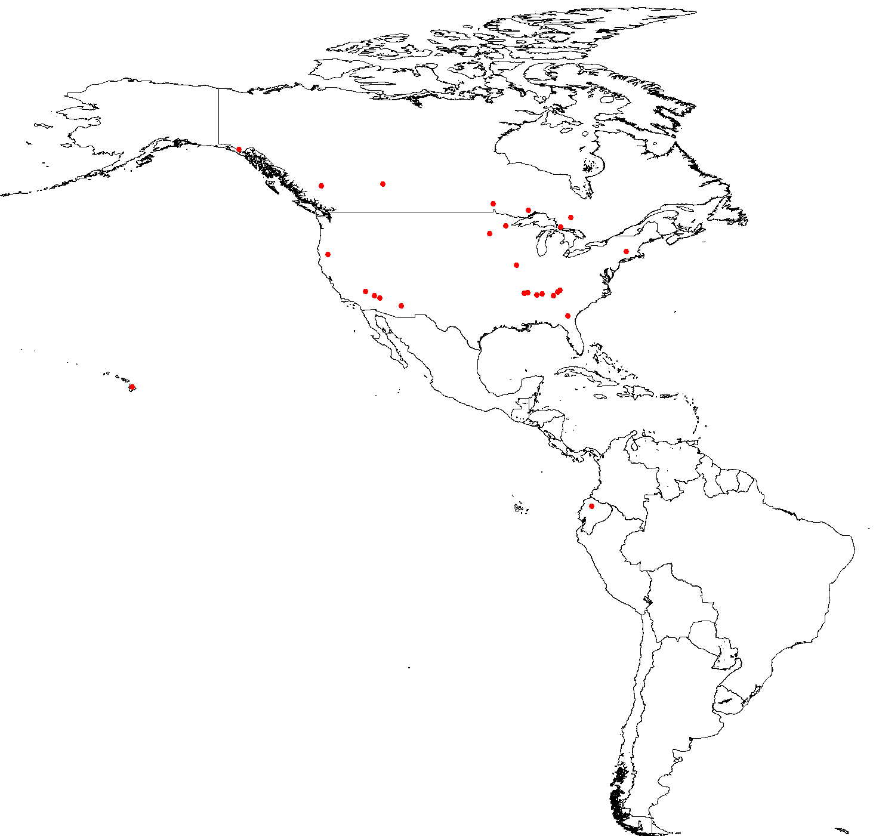
Confirmed measles cases by second administrative level
The Americas, 2011, 2014, 2015, and 2016*
2011
N=1,369 cases
2014
N=1,966 cases
2015
N=611 cases
Brazil= 214
Canada= 196
Colombia=1
Chile=9
Mexico= 1
United States= 186
Peru=4
Total (2015)= 611
Canada= 8
Ecuador=1
United States= 35
Total (2016)= 44
2016*
N=27 cases
Source: Country reports to FGL-IM/PAHO.
*Data as of epidemiological week 27, 2016
Notes:
We can see here the big outbreaks in Canada, Ecuador, USA an Brazil In 2011, 2014 and 2015

