Slide 1
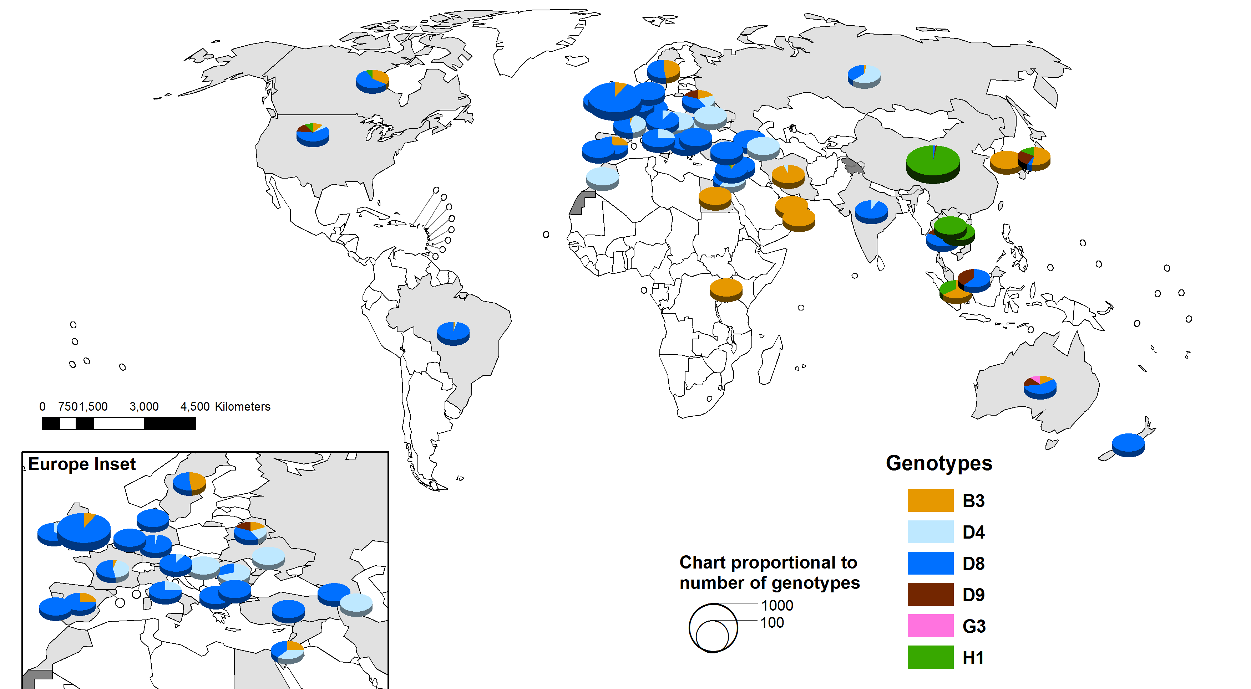
Distribution of measles genotypes (Oct 2012 - Sep 2013)
Data source: MeaNS Database
Updated on 21 October 2013

