Slide 1
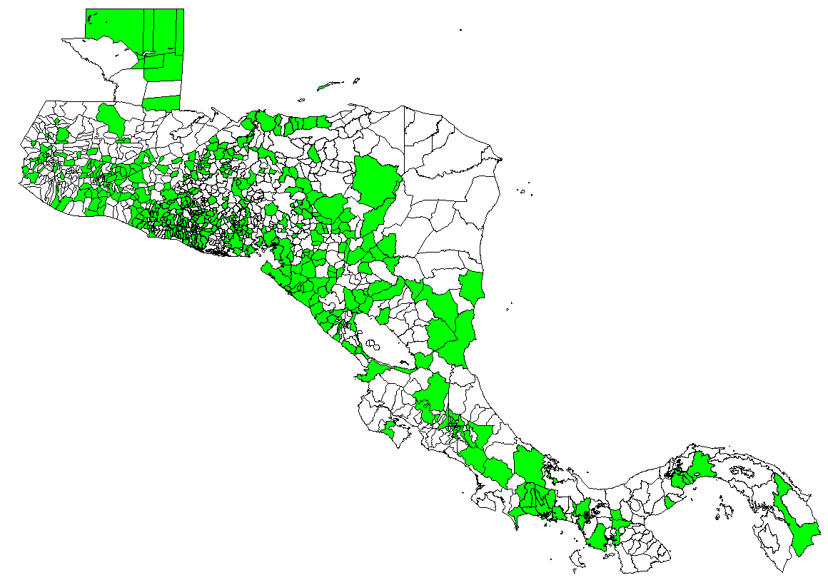
Percentage of municipalities reporting suspected cases of measles and rubella. Central America, January-December, 2014
N=1,207 (47%)
Suspected case
Source: Country reports to FGL/IM, PAHO.

