Slide 1
Global Youth Tobacco Survey (GYTS): Overview

Slide 2
Overview
GYTS Background and Purpose
GYTS Protocol
Country Engagement
Protocol Adaptation
Fieldwork
Data Analysis and Reporting

Slide 3
GYTS Background and Purpose

Slide 4
GYTS Background
Launched in 1999 as a WHO and CDC joint collaboration
Nationally representative, school-based survey that collects data on students aged 13–15 years
Monitors youth tobacco use (smoking and smokeless) and tracks key tobacco-control indicators
Uses an appropriate statistical methodology to construct the sampling frame, select schools and classes, and process the data
GYTS is designed to produce cross-sectional estimates for each country

Slide 5
GYTS Background
One of the largest public health surveillance systems, with surveys conducted in more than 185 countries/sites
GYTS is structured to collect data that are comparable within and across countries
Countries are expected to repeat the survey every 4 to 5 years to generate new data

Slide 6
GYTS Purpose
GYTS’s purpose is to enhance countries’ capacity to develop, implement, and evaluate tobacco control interventions
It is an important tool to assist countries in supporting the WHO MPOWER technical package contained in the WHO Framework Convention for Tobacco Control
GYTS data helps
Establish quantifiable evidence that tobacco is a serious issue among youth
Monitor progress in tobacco control

Slide 7
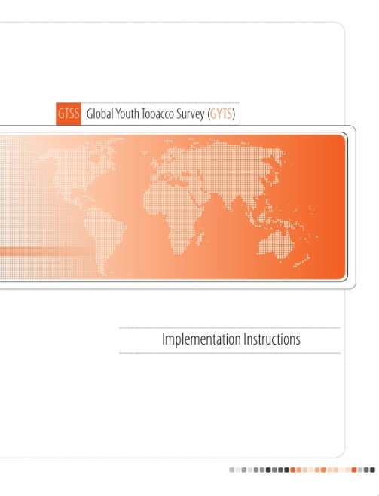
Documents Referenced
GYTS Implementation Instructions
Introduction
Country Engagement Process
Protocol Adaptation
Fieldwork Implementation
Data Analysis and Reporting
Appendices

Slide 8
GYTS Overview: Process Stages

Slide 9
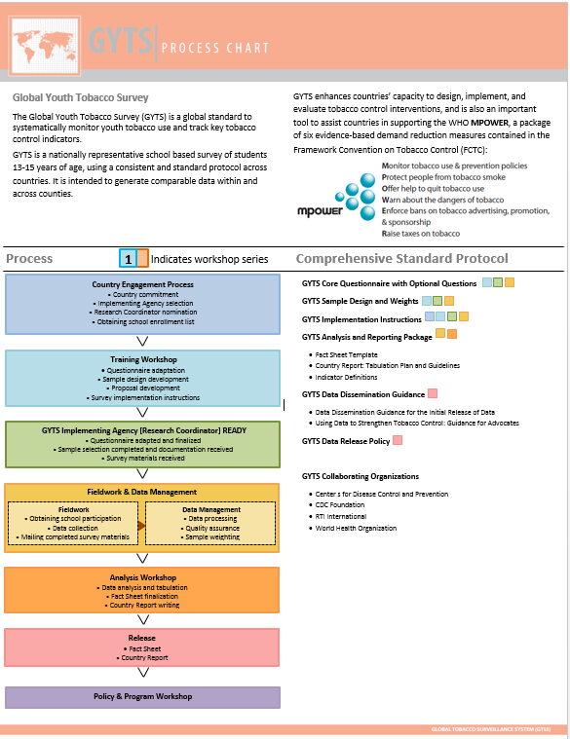
GYTS Protocol
Stages of GYTS Implementation
Country Engagement
Training Workshop
GYTS Implementing Agency/ Research Coordinator Readiness
Fieldwork and Data Management
Analysis Workshop
Data Release
Policy and Program Workshop

Slide 10
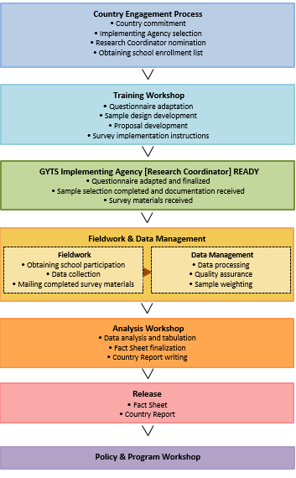
GYTS Process
Country Engagement
Obtain country commitment from Ministry of Health or Ministry of Education
Select Implementing Agency (IA)
Nominate Research Coordinator (RC)
Obtain the school enrollment list
Used to draw the school sample

Slide 11
GYTS Process
Country Engagement
Training Workshop
Questionnaire Adaptation
Sample Design Development
Proposal Development
Survey Implementation Instructions

Slide 12
GYTS Process
Country Engagement
Training Workshop
Implementing Agency and RC Readiness
Agency and RC play key roles managing implementation tasks
Ensure review and finalization of adapted questionnaire
Finalize sample design and school enrollment list
Complete sample selection
Receive survey materials

Slide 13
GYTS Process
Country Engagement
Training Workshop
Implementing Agency and RC Readiness
Fieldwork
RC obtains school participation, schedules the survey, trains Fieldworkers, reviews collected data, and submits data to CDC
Fieldworkers administer the survey, collect the data, document school and class participation, and submit data to the RC

Slide 14
GYTS Process
Country Engagement
Training Workshop
Implementing Agency and RC Readiness
Fieldwork
Data Management
Data processing, quality assurance, and sample weighting
Data set, reports, and tables sent to RC for review

Slide 15
GYTS Process
Country Engagement
Training Workshop
Implementing Agency and RC Readiness
Fieldwork
Data Management
Analysis Workshop
Learn about data processing and analysis
Finalize Fact Sheets
Draft Country Reports
Discuss dissemination plans
Receive Epi Info training

Slide 16
GYTS Process
Country Engagement
Training Workshop
Implementing Agency and RC Readiness
Fieldwork
Data Management
Analysis Workshop
Data Release
Release of Fact Sheets and Country Reports
Explore strategies/topics for scientific publications

Slide 17
GYTS Process
Country Engagement
Training Workshop
Implementing Agency and RC Readiness
Fieldwork
Data Management
Analysis Workshop
Data Release
Policy and Program Workshop
Optimize impact of GYTS data and results

Slide 18
End of this session THANK YOU!

